Slide 1
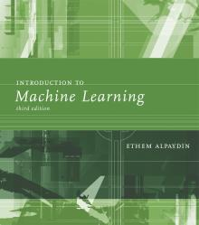
INTRODUCTION TO Machine Learning 3rd Edition
Lecture Slides for
ETHEM ALPAYDIN
© The MIT Press, 2014
alpaydin@boun.edu.tr
http://www.cmpe.boun.edu.tr/~ethem/i2ml3e

Slide 2
CHAPTER 13: Kernel Machines

Slide 3
Kernel Machines
Discriminant-based: No need to estimate densities first
Define the discriminant in terms of support vectors
The use of kernel functions, application-specific measures of similarity
No need to represent instances as vectors
Convex optimization problems with a unique solution

Slide 4
Optimal Separating Hyperplane
(Cortes and Vapnik, 1995; Vapnik, 1995)

Slide 5
Margin
Distance from the discriminant to the closest instances on either side
Distance of x to the hyperplane is
We require
For a unique sol’n, fix ρ||w||=1, and to max margin

Slide 6
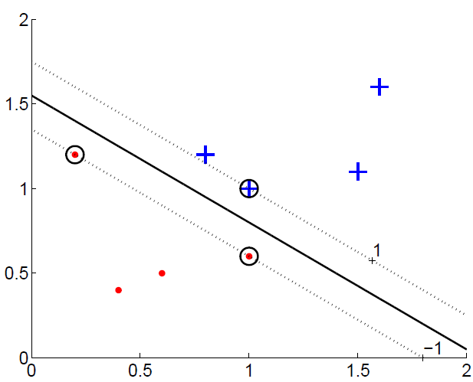
Margin

Slide 8
Most α^{t} are 0 and only a small number have α^{t} >0; they are the support vectors

Slide 9
Soft Margin Hyperplane
Not linearly separable
Soft error
New primal is

Slide 10
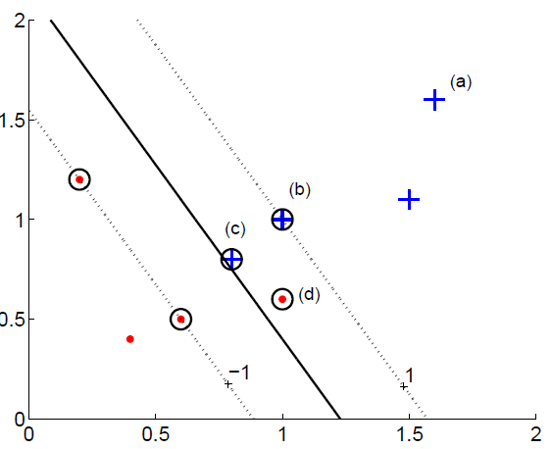

Slide 11
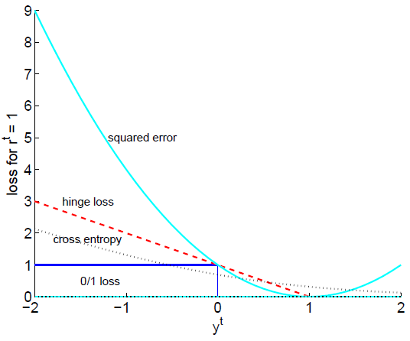
Hinge Loss

Slide 12
ν-SVM
ν controls the fraction of support vectors

Slide 13
Kernel Trick
Preprocess input x by basis functions
z = φ(x) g(z)=w^{T}z
g(x)=w^{T} φ(x)
The SVM solution

Slide 14
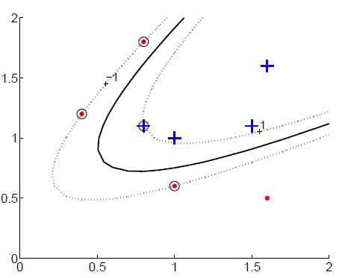
Vectorial Kernels
Polynomials of degree q:

Slide 15
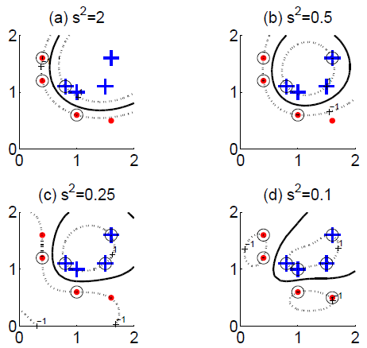
Vectorial Kernels
Radial-basis functions:

Slide 16
Defining kernels
Kernel “engineering”
Defining good measures of similarity
String kernels, graph kernels, image kernels, ...
Empirical kernel map: Define a set of templates m_{i} and score function s(x,m_{i})
φ(x^{t})=[s(x^{t},m₁), s(x^{t},m₂),..., s(x^{t},m_{M})]
and
K(x,x^{t})=φ (x)^{T} φ (x^{t})

Slide 17
Multiple Kernel Learning
Fixed kernel combination
Adaptive kernel combination
Localized kernel combination

Slide 18
Multiclass Kernel Machines
1-vs-all
Pairwise separation
Error-Correcting Output Codes (section 17.5)
Single multiclass optimization

Slide 19
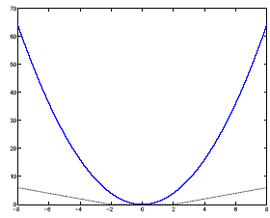
SVM for Regression
Use a linear model (possibly kernelized)
f(x)=w^{T}x+w₀
Use the є-sensitive error function

Slide 20
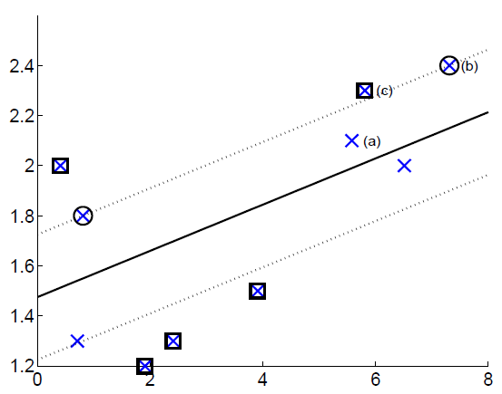

Slide 21
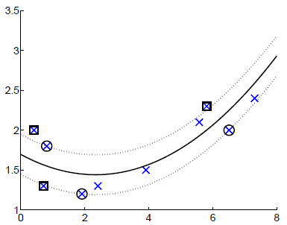
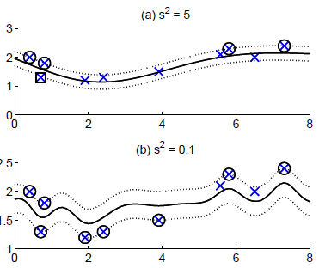
Kernel Regression
Polynomial kernel
Gaussian kernel

Slide 22
Kernel Machines for Ranking
We require not only that scores be correct order but at least +1 unit margin.
Linear case:

Slide 23
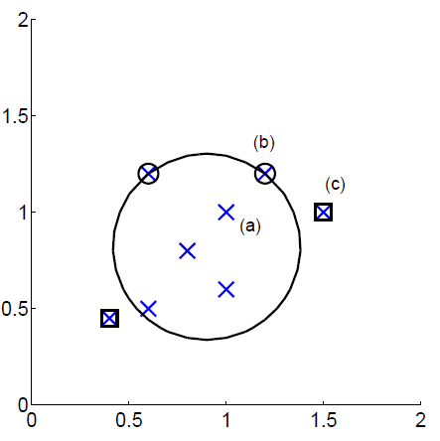
One-Class Kernel Machines
Consider a sphere with center a and radius R

Slide 24
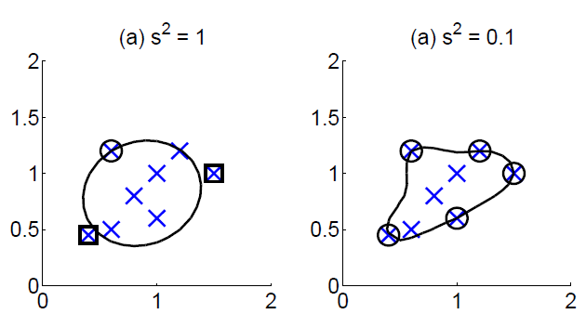

Slide 25
Large Margin Nearest Neighbor
Learns the matrix M of Mahalanobis metric
D(x^{i}, x^{j})=(x^{i}-x^{j})^{T}M(x^{i}-x^{j})
For three instances i, j, and l, where i and j are of the same class and l different, we require
D(x^{i}, x^{l}) > D(x^{i}, x^{j})+1
and if this is not satisfied, we have a slack for the difference and we learn M to minimize the sum of such slacks over all i,j,l triples (j and l being one of k neighbors of i, over all i)

Slide 26
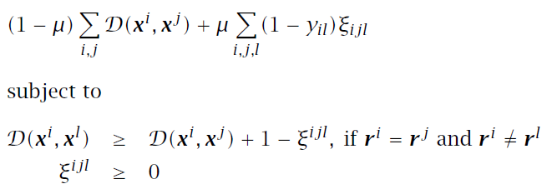
Learning a Distance Measure
LMNN algorithm (Weinberger and Saul 2009)
LMCA algorithm (Torresani and Lee 2007) uses a similar approach where M=L^{T}L and learns L

Slide 27
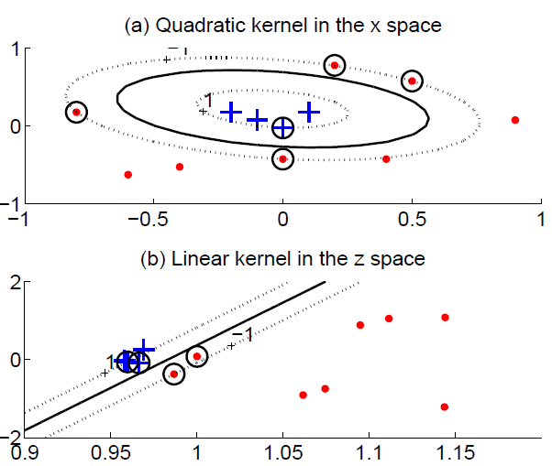
Kernel Dimensionality Reduction
Kernel PCA does PCA on the kernel matrix (equal to canonical PCA with a linear kernel)
Kernel LDA, CCA

