Slide 1
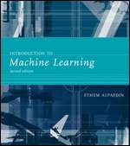
INTRODUCTION TO
Machine Learning
2nd Edition
Lecture Slides for
ETHEM ALPAYDIN
© The MIT Press, 2010
alpaydin@boun.edu.tr
http://www.cmpe.boun.edu.tr/~ethem/i2ml2e

Slide 2
CHAPTER 6:
Dimensionality Reduction

Slide 3
Why Reduce Dimensionality?
Reduces time complexity: Less computation
Reduces space complexity: Less parameters
Saves the cost of observing the feature
Simpler models are more robust on small datasets
More interpretable; simpler explanation
Data visualization (structure, groups, outliers, etc) if plotted in 2 or 3 dimensions

Slide 4
Feature Selection vs Extraction
Feature selection: Choosing k<d important features, ignoring the remaining d – k
Subset selection algorithms
Feature extraction: Project the
original x_{i} , i =1,...,d dimensions to
new k<d dimensions, z_{j} , j =1,...,k
Principal components analysis (PCA), linear discriminant analysis (LDA), factor analysis (FA)

Slide 5
Subset Selection
There are 2^{d} subsets of d features
Forward search: Add the best feature at each step
  Set of features F initially Ø.
  At each iteration, find the best new feature
    j = argmin_{i} E ( F ∪ x_{i} )
  Add x_{j} to F if E ( F ∪ x_{j} ) < E ( F )
Hill-climbing O(d²) algorithm
Backward search: Start with all features and remove one at a time, if possible.
Floating search (Add k, remove l)

Slide 6
Principal Components Analysis (PCA)
Find a low-dimensional space such that when x is projected there, information loss is minimized.
The projection of x on the direction of w is: z = w^{T}x
Find w such that Var(z) is maximized
Var(z) = Var(w^{T}x) = E[(w^{T}x – w^{T}μ)²]
= E[(w^{T}x – w^{T}μ)(w^{T}x – w^{T}μ)]
= E[w^{T}(x – μ)(x – μ)^{T}w]
= w^{T} E[(x – μ)(x –μ)^{T}]w = w^{T} ∑ w
where Var(x)= E[(x – μ)(x –μ)^{T}] = ∑

Slide 7
Maximize Var(z) subject to ||w||=1
  ∑w₁ = αw₁ that is, w₁ is an eigenvector of ∑
  Choose the one with the largest eigenvalue for Var(z) to be max
Second principal component: Max Var(z₂), s.t., ||w₂||=1 and orthogonal to w₁
  ∑ w₂ = α w₂ that is, w₂ is another eigenvector of ∑
and so on.

Slide 8
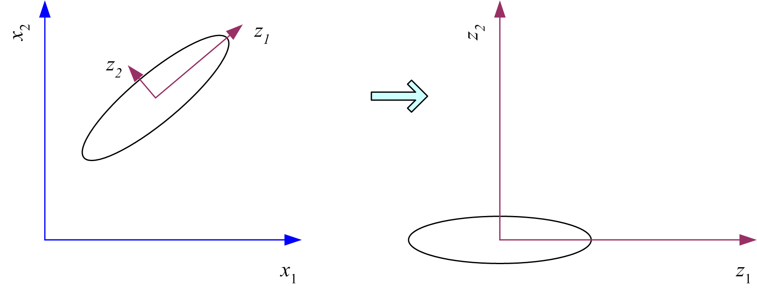
What PCA does
z = W^{T}(x – m)
where the columns of W are the eigenvectors of ∑, and m is sample mean
Centers the data at the origin and rotates the axes

Slide 9
How to choose k ?
Proportion of Variance (PoV) explained
when λ_{i} are sorted in descending order
Typically, stop at PoV>0.9
Scree graph plots of PoV vs k, stop at “elbow”

Slide 10
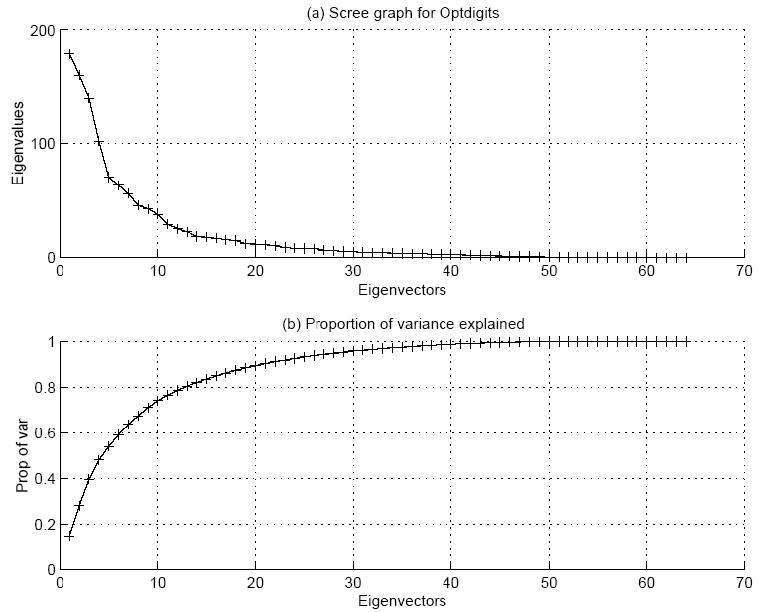

Slide 11
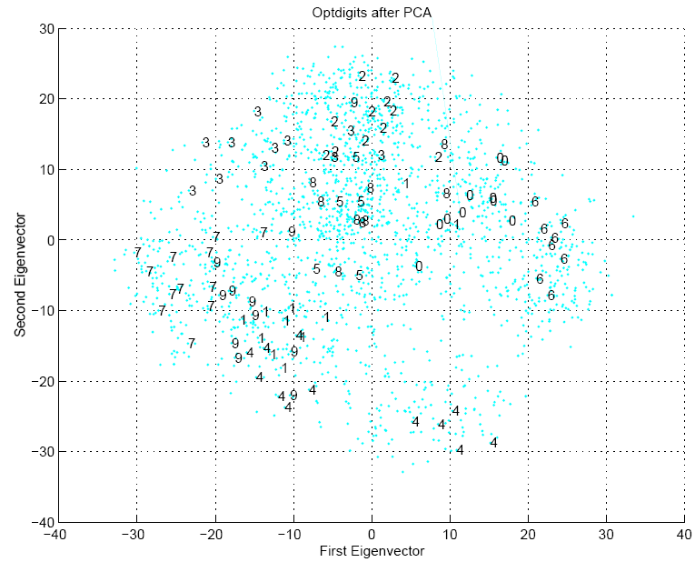

Slide 12
Factor Analysis
Find a small number of factors z, which when combined generate x :
x_{i} – µ_{i} = v_{i1}z₁ + v_{i2}z₂ + ... + v_{ik}z_{k} + ε_{i}
where z_{j}, j =1,...,k are the latent factors with
E[ z_{j} ]=0, Var(z_{j})=1, Cov(z_{i ,}, z_{j})=0, i ≠ j ,
ε_{i} are the noise sources
E[ ε_{i} ]= ψ_{i}, Cov(ε_{i} , ε_{j}) =0, i ≠ j, Cov(ε_{i} , z_{j}) =0 ,
and v_{ij} are the factor loadings

Slide 13
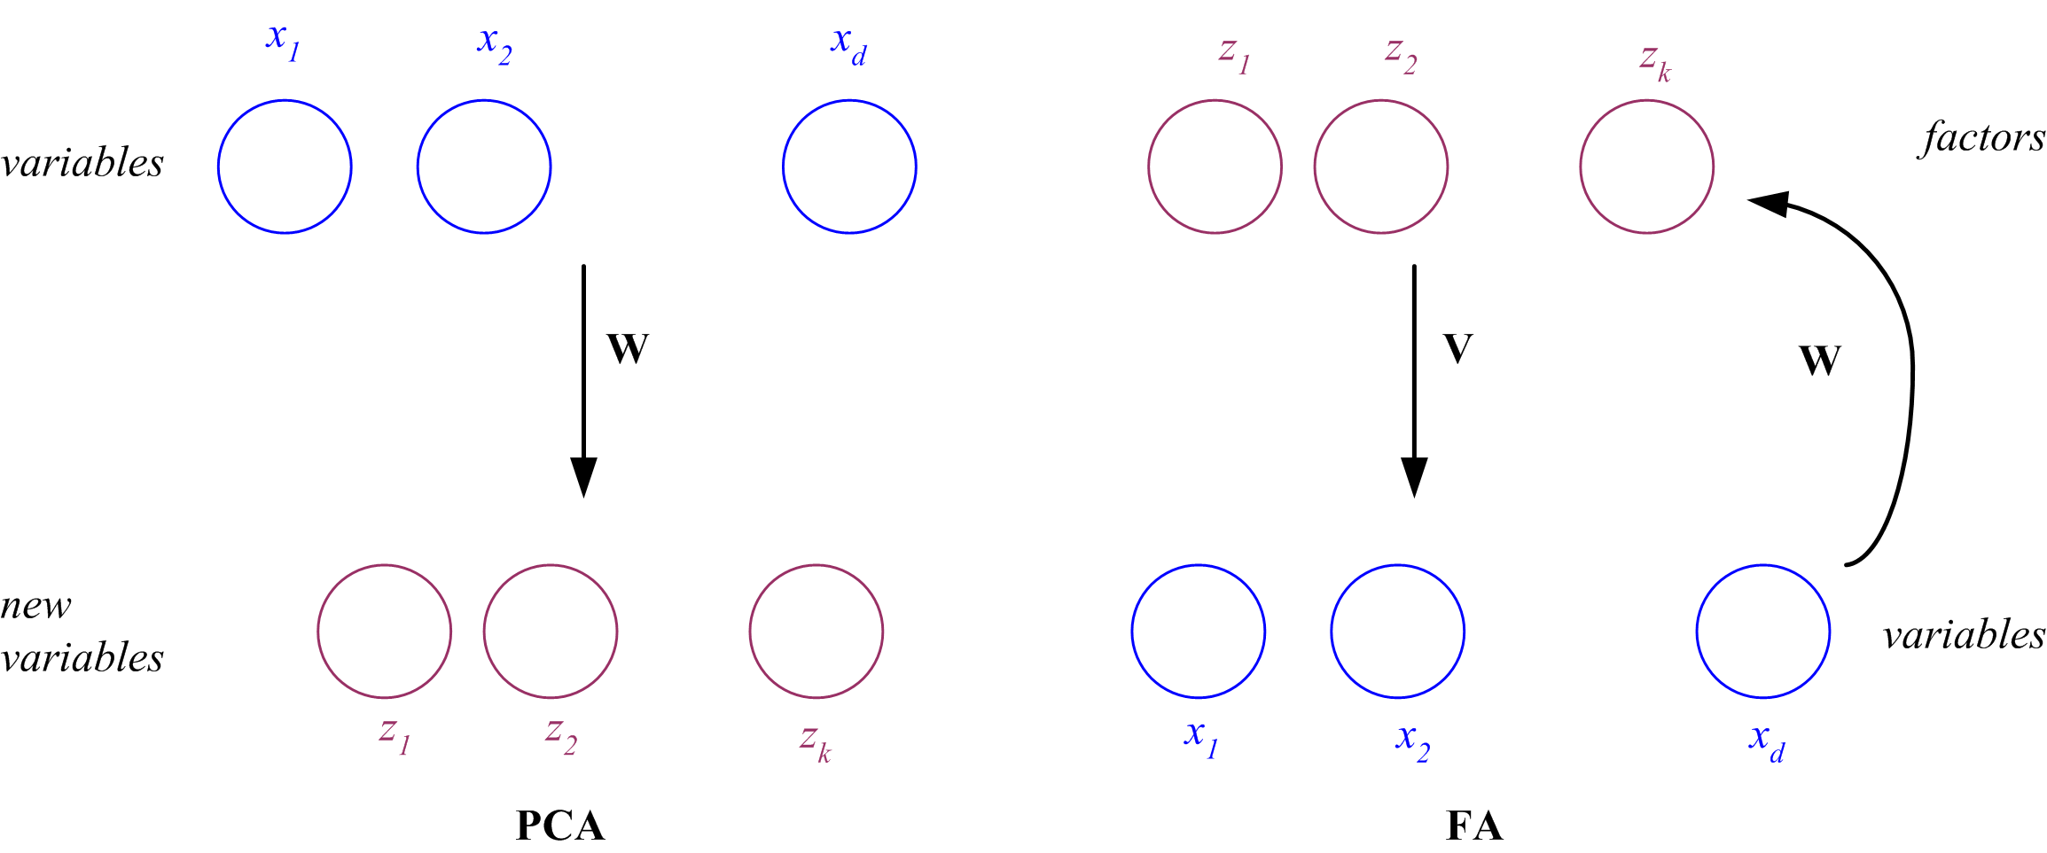
PCA vs FA
PCA From x to z z = W^{T}(x – µ)
FA From z to x x – µ = Vz + ε
x
z
z
x

Slide 14
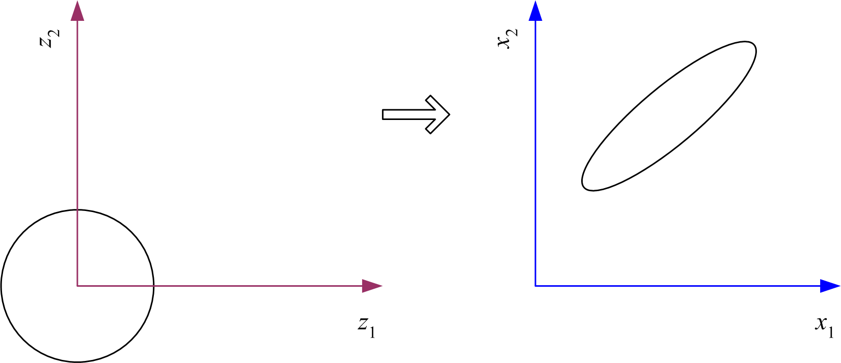
Factor Analysis
In FA, factors z_{j} are stretched, rotated and translated to generate x

Slide 15
Multidimensional Scaling
Given pairwise distances between N points,
d_{ij}, i,j =1,...,N
place on a low-dim map s.t. distances are preserved.
z = g (x | θ ) Find θ that min Sammon stress

Slide 16
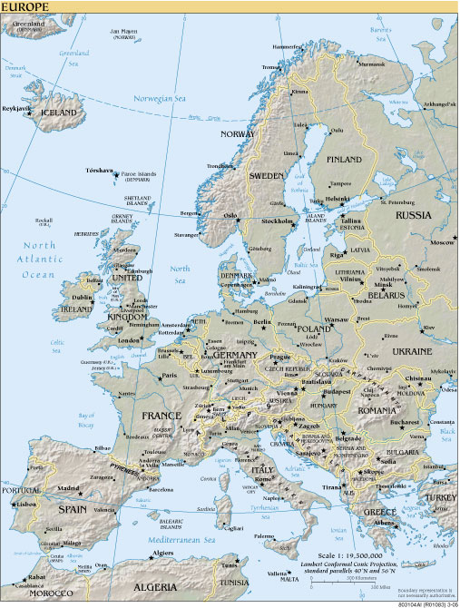
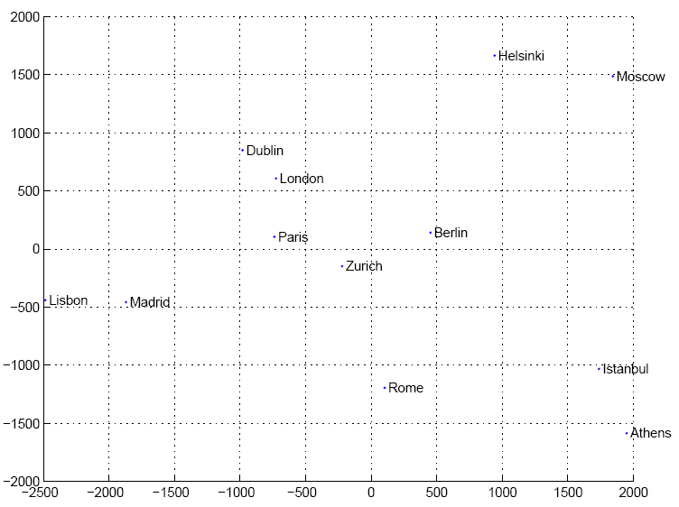
Map of Europe by MDS
Map from CIA – The World Factbook: http://www.cia.gov/

Slide 17
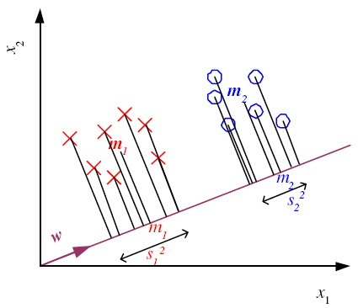
Linear Discriminant Analysis
Find a low-dimensional space such that when x is projected, classes are well-separated.
Find w that maximizes

Slide 18
Between-class scatter:
Within-class scatter:

Slide 19
Fisher’s Linear Discriminant
Find w that max
LDA soln:
Parametric soln:

Slide 20
K>2 Classes
Within-class scatter:
Between-class scatter:
Find W that max
The largest eigenvectors of S_{W}⁻¹S_{B}
Maximum rank of K-1

Slide 21
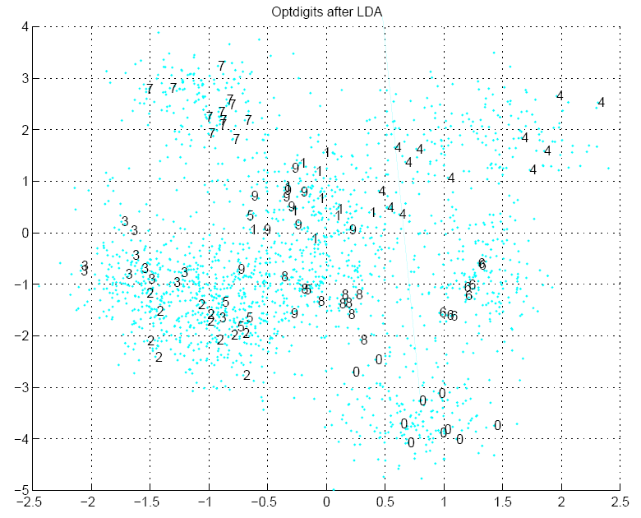

Slide 22
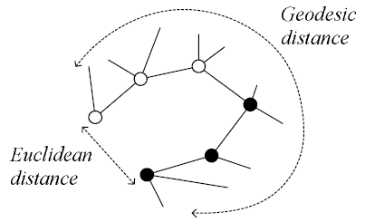
Isomap
Geodesic distance is the distance along the manifold that the data lies in, as opposed to the Euclidean distance in the input space

Slide 23
Isomap
Instances r and s are connected in the graph if
  ||x^{r}-x^{s}||<ε or if x^{s} is one of the k neighbors of x^{r}
  The edge length is ||x^{r}-x^{s}||
For two nodes r and s not connected, the distance is equal to the shortest path between them
Once the NxN distance matrix is thus formed, use MDS to find a lower-dimensional mapping

Slide 24
Matlab source from http://web.mit.edu/cocosci/isomap/isomap.html

Slide 25
Locally Linear Embedding
Given x^{r} find its neighbors x^{s}_{(r)}
Find W_{rs} that minimize
Find the new coordinates z^{r} that minimize

Slide 26
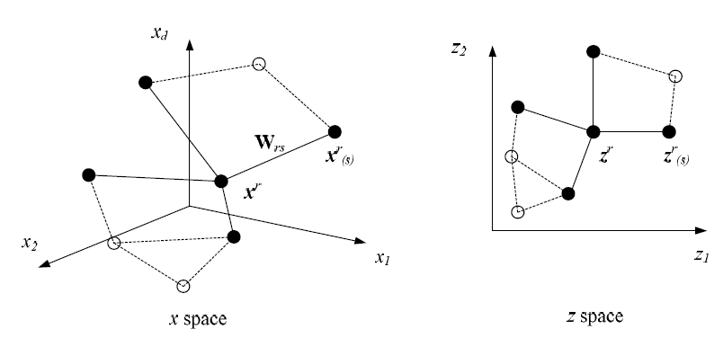

Slide 27
LLE on Optdigits
Matlab source from http://www.cs.toronto.edu/~roweis/lle/code.html

