Slide 1
INTRODUCTION TO Machine Learning 2nd Edition
Lecture Slides for
ETHEM ALPAYDIN
© The MIT Press, 2010
alpaydin@boun.edu.tr
http://www.cmpe.boun.edu.tr/~ethem/i2ml2e

Slide 2
CHAPTER 19: Design and Analysis of Machine Learning Experiments

Slide 3
Introduction
Questions:
Assessment of the expected error of a learning algorithm: Is the error rate of 1-NN less than 2%?
Comparing the expected errors of two algorithms: Is k-NN more accurate than MLP ?
Training/validation/test sets
Resampling methods: K-fold cross-validation

Slide 4
Algorithm Preference
Criteria (Application-dependent):
Misclassification error, or risk (loss functions)
Training time/space complexity
Testing time/space complexity
Interpretability
Easy programmability
Cost-sensitive learning

Slide 5
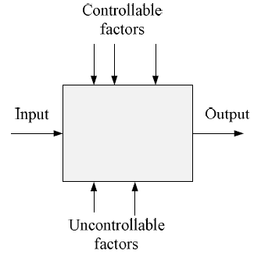
Factors and Response

Slide 6
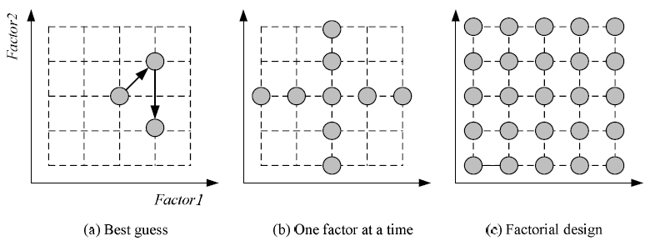
Strategies of Experimentation
Response surface design for approximating and maximizing
the response function in terms of the controllable factors

Slide 7
Guidelines for ML experiments
Aim of the study
Selection of the response variable
Choice of factors and levels
Choice of experimental design
Performing the experiment
Statistical Analysis of the Data
Conclusions and Recommendations

Slide 8
Resampling and K-Fold Cross-Validation
The need for multiple training/validation sets
{X_{i},V_{i}}_{i}: Training/validation sets of fold i
K-fold cross-validation: Divide X into k, X_{i},i=1,...,K
T_{i} share K-2 parts

Slide 9
5×2 Cross-Validation
5 times 2 fold cross-validation (Dietterich, 1998)

Slide 10
Bootstrapping
Draw instances from a dataset with replacement
Prob that we do not pick an instance after N draws
that is, only 36.8% is new!

Slide 11
Measuring Error
Error rate = # of errors / # of instances = (FN+FP) / N
Recall = # of found positives / # of positives
= TP / (TP+FN) = sensitivity = hit rate
Precision = # of found positives / # of found
= TP / (TP+FP)
Specificity = TN / (TN+FP)
False alarm rate = FP / (FP+TN) = 1 - Specificity

Slide 12
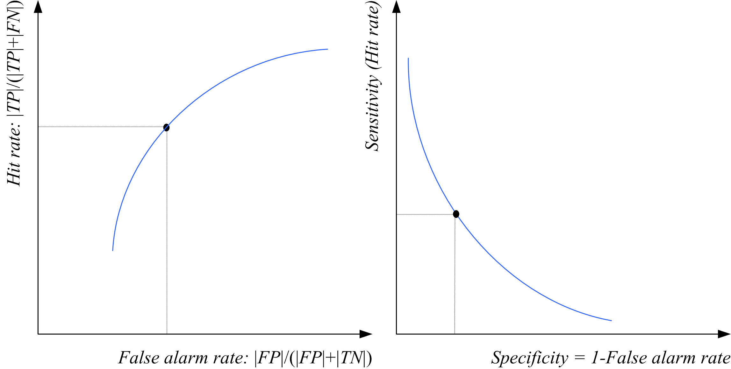
ROC Curve

Slide 13
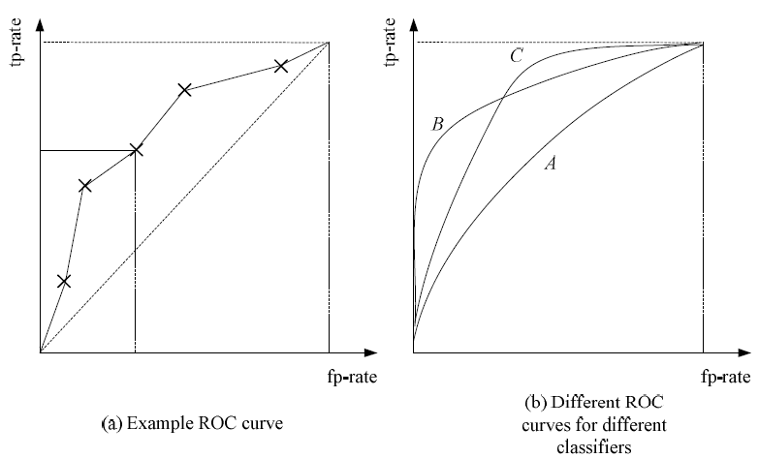

Slide 14
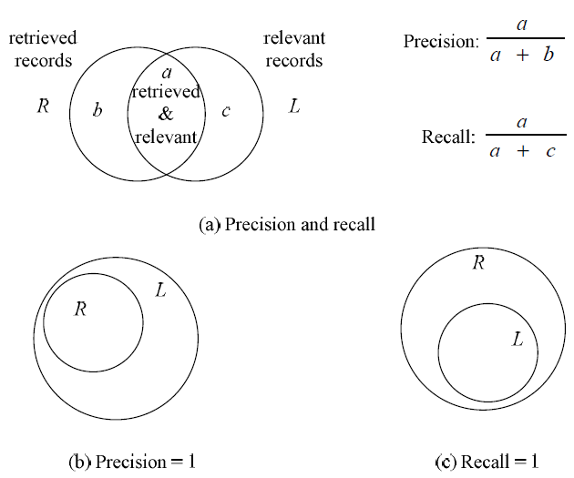
Precision and Recall

Slide 15
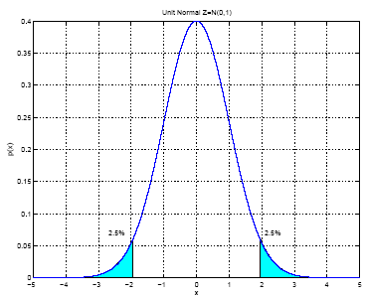
Interval Estimation
X = { x^{t} }_{t} where x^{t} ~ N ( μ, σ²)
m ~ N ( μ, σ²/N)
100(1- α) percent
confidence
interval

Slide 16
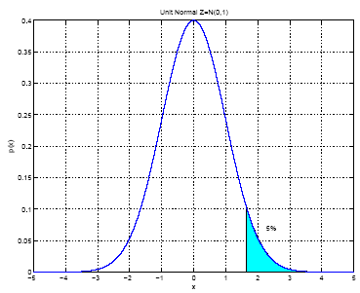
When σ² is not known:

Slide 17
Hypothesis Testing
Reject a null hypothesis if not supported by the sample with enough confidence
X = { x^{t} }_{t} where x^{t} ~ N ( μ, σ²)
H₀: μ = μ₀ vs. H₁: μ ≠ μ₀
Accept H₀ with level of significance α if μ₀ is in the
100(1- α) confidence interval
Two-sided test

Slide 18
One-sided test: H₀: μ ≤ μ₀ vs. H₁: μ > μ₀
Accept if
Variance unknown: Use t, instead of z
Accept H₀: μ = μ₀ if

Slide 19
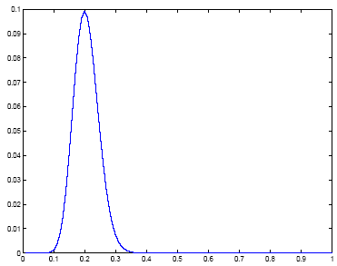
Assessing Error: H₀: p ≤ p₀ vs. H₁: p > p₀
Single training/validation set: Binomial Test
If error prob is p₀, prob that there are e errors or less in N validation trials is
Accept if this prob is less than 1- α
N=100, e=20
1- α

Slide 20
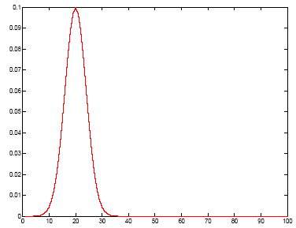
Normal Approximation to the Binomial
Number of errors X is approx N with mean Np₀ and var Np₀(1-p₀)
Accept if this prob for X = e is
less than z_{1-α}
1- α

Slide 21
t Test
Multiple training/validation sets
x^{t}_{i} = 1 if instance t misclassified on fold i
Error rate of fold i:
With m and s² average and var of p_{i} , we accept p₀ or less error if
is less than t_{α,K-1}

Slide 22
Comparing Classifiers: H₀: μ₀ = μ₁ vs. H₁: μ₀ ≠ μ₁
Single training/validation set: McNemar’s Test
Under H₀, we expect e₀₁= e₁₀=(e₀₁+ e₁₀)/2
Accept if < X²_{α,1}

Slide 23
K-Fold CV Paired t Test
Use K-fold cv to get K training/validation folds
p_{i}¹, p_{i}²: Errors of classifiers 1 and 2 on fold i
p_{i} = p_{i}¹ – p_{i}² : Paired difference on fold i
The null hypothesis is whether p_{i} has mean 0

Slide 24
5×2 cv Paired t Test
Use 5×2 cv to get 2 folds of 5 tra/val replications (Dietterich, 1998)
p_{i}^{(j)} : difference btw errors of 1 and 2 on fold j=1, 2 of replication i=1,...,5
Two-sided test: Accept H₀: μ₀ = μ₁ if in (-t_{α/2,5},t_{α/2,5})
One-sided test: Accept H₀: μ₀ ≤ μ₁ if < t_{α,5}

Slide 25
5×2 cv Paired F Test
Two-sided test: Accept H₀: μ₀ = μ₁ if < F_{α,10,5}

Slide 26
Comparing L>2 Algorithms: Analysis of Variance (Anova)
Errors of L algorithms on K folds
We construct two estimators to σ² .
One is valid if H₀ is true, the other is always valid.
We reject H₀ if the two estimators disagree.

Slide 29
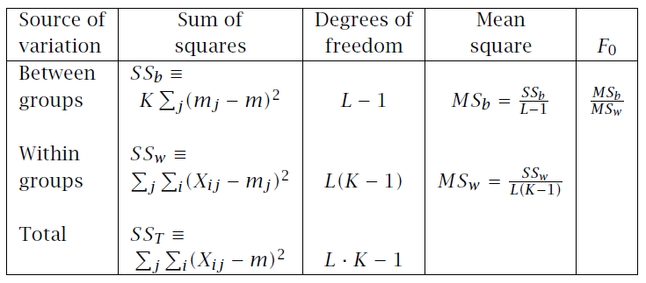
ANOVA table
If ANOVA rejects, we do pairwise posthoc tests

Slide 30
Comparison over Multiple Datasets
Comparing two algorithms:
Sign test: Count how many times A beats B over N datasets, and check if this could have been by chance if A and B did have the same error rate
Comparing multiple algorithms
Kruskal-Wallis test: Calculate the average rank of all algorithms on N datasets, and check if these could have been by chance if they all had equal error
If KW rejects, we do pairwise posthoc tests to find which ones have significant rank difference

