Slide 1
Machine Learning for Big Data, Methods and Applications
Büyük Veri Madenciliği ve Yapay Öğrenme
A. Taylan Cemgil
24.12.2012, ITO Istanbul

Slide 2
Outline
Machine Learning
Use Cases
Supervised Learning
  Classification
Unsupervised Learning
  Clustering
  Dimensionality Reduction
Probabilistic Approach to Machine Learning
  Probability Theory
  Graphical Models, Probabilistic Expert Systems
  Time Series
  Matrix and Tensor Factorization
  Sensor Fusion
Scaling up Machine Learning
  Architectures
References

Slide 3
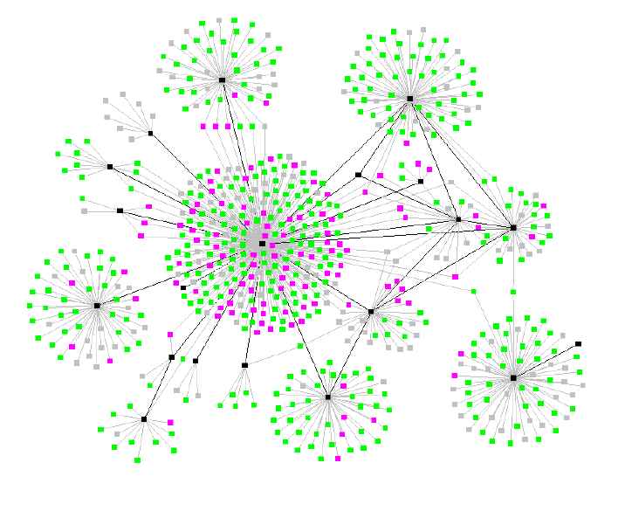
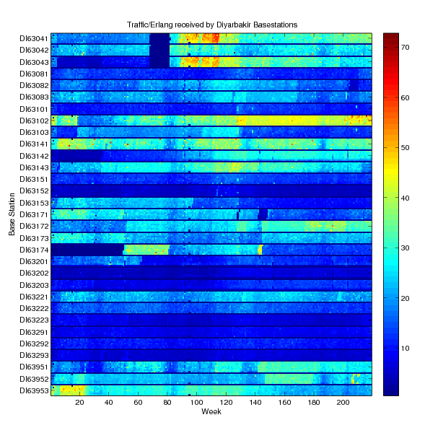
What is Machine Learning?
Collection of computational methods to …
  Detect hidden patterns in data
  Create useful predictions about unseen data
  Decision making under uncertainty
  Transform raw data into useful knowledge

Slide 4
Machine Learning
Mathematics and Statistics
Electrical Engineering
Pattern Recognition
Computer Science
Databases
Parallel Processing
Optimization
Numerical Linear Algebra
Artificial Intelligence
Signal processing
Detection/Estimation
Information Retrieval
Information Theory
Graphics/Visualization
Probability Theory
Data Compression

Slide 5
Data Mining, Machine Learning, Statistics
Facets of the same problem
Differences in emphasis/terminology
Historical Evolution of the fields
  Data Mining: Database systems, Data Structures
  Statistics: Probability Theory, Mathematics
  Machine Learning: Artificial Intelligence, Pattern Recognition

Slide 6
Is ML for Big Data a new concept ?
Thinking about old methods with a new mind set
… and invent new ones
Curse/Blessing of Dimensionality
Infrastructure is cheaper
  Cloud Computing
  Sensor Networks (“new kind of data”)
  Speed (“real time”)

Slide 7
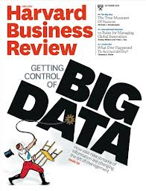
Big Potential for Economic Impact
Emphasis on System Integration
Reached Critical Mass/Mature technology

Slide 8
Moore’s Law to Rescue?
“data explosion is bigger than Moore's law”
Computers get faster and cheaper every year but the amount of data that needs to be processed grows even faster.
DATA
CPU

Slide 9
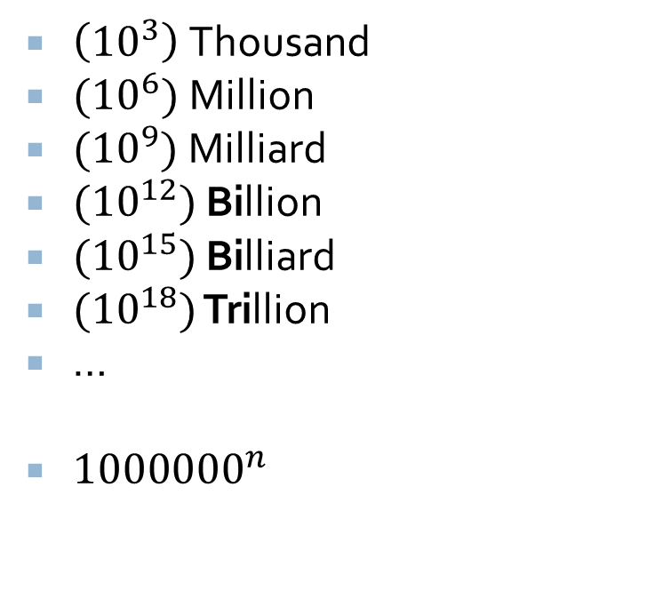

Large Numbers
American/Turkish (Short)
European (Long)
$\left({10}^{3}\right)$Thousand
${(10}^{6})$Million
${(10}^{9})$ Billion
${(10}^{12})$ Trillion
${(10}^{15})$ Quadrillion
${(10}^{18})$ Quintillion
…
$1000×{1000}^{n}$
$\left({10}^{3}\right)$Thousand
${(10}^{6})$Million
${(10}^{9})$Milliard
${(10}^{12})$ Billion
${(10}^{15})$ Billiard
${(10}^{18})$ Trillion
…
${1000000}^{n}$

Slide 10
Storage Sizes
kilobyte (kB) | 10³ | 2¹⁰
megabyte (MB) | 10⁶ | 2²⁰
gigabyte (GB) | 10⁹ | 2³⁰
terabyte (TB) | 10¹² | 2⁴⁰
petabyte (PB) | 10¹⁵ | 2⁵⁰
exabyte (EB) | 10¹⁸ | 2⁶⁰
zettabyte (ZB) | 10²¹ | 2⁷⁰
yottabyte (YB) | 10²⁴ | 2⁸⁰

Slide 11
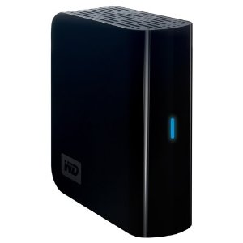
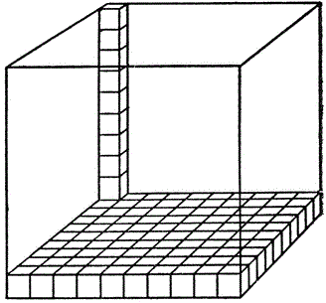

Storage Sizes
= 1TB = 1 000 000 000 000 Bytes
=1 Trillion Bytes
= 1PB
= 1 000 000 000 000 000B =1 Quadrillion Bytes

Slide 12


Some Figures
CERN: Large Hadron Collider produces about 15 petabytes of data per year
Google processes about 24 petabytes of data per day.
$$×15 000$$
$$×24 000$$

Slide 13


Some Figures
Facebook’s Hadoop Distributed File System (HDFS) is reported to be about 100 PB
$$×100 000$$
Global Internet Traffic per month in 2011 is estimated to be about 27500 PB (Source:Cisco)
$$×27 500 000$$

Slide 14

Data $=$Information $≠$Knowledge
We are drowning in data and starving for knowledge
– J. Naisbitt
(from Machine Learning, a probabilistic perspective, KP Murphy)

Slide 15
Use Cases: Retail/Consumer
Product Recommendation
Market Basket Analysis
Event/Activity/Behavior Analysis
Campaign management and optimization
Supply-chain management and analytics
Market and consumer segmentations

Slide 16

Use Case: Recommendation System
Netflix: 18K movies $×$500K users %99 sparse

Slide 17
Use Case: Telecommunications
Network Monitoring and Performance Optimization
Pricing Optimization
Customer Churn Management
Call Detail Record (CDR) Analysis
(Mobile) User Behavior Analysis
Cybersecurity, Detection and Prevention of DDOS Attacks
Infrastructure Planning

Slide 18
Use Cases, Example

Slide 19
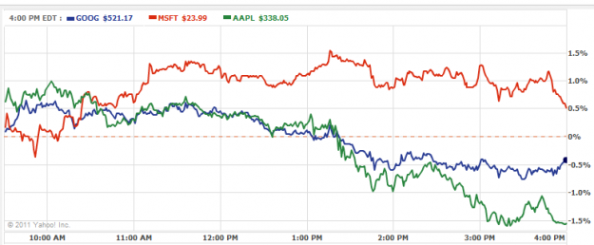
Use Cases: Finance/Trading/Banking
Fraud Detection/Risk Estimation
High Speed Trading
Anomality/Changepoint Detection

Slide 20
Use Cases: Web
Clickstream Segmentation and Analysis
Ad Targeting/Selection, Forecasting and Optimization
Click Fraud Detection/Prevention
Social Graph Analysis
Customer Segmentation
Newsgroup/Blog/Social Media opinion tracking

Slide 21
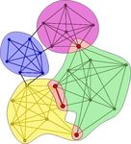

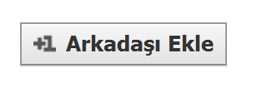
Use Cases, Example
Community Detection (source: matlab exchange)

Slide 22
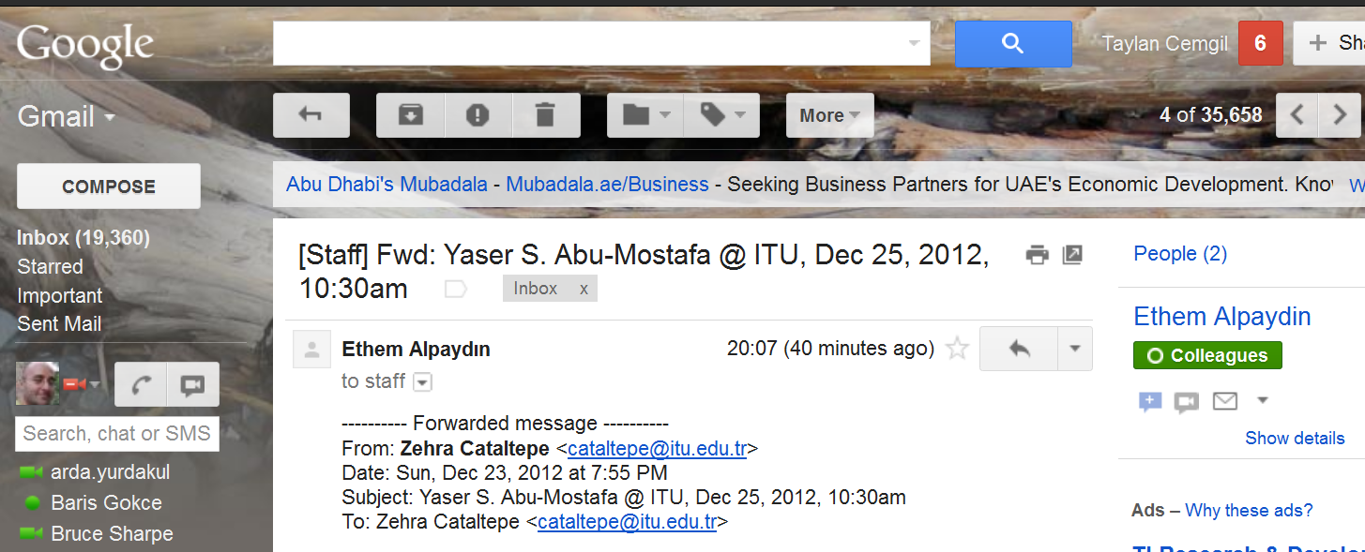
Use Cases, Example
Ad Personalization: Match ads with users
  Key income generator for Google, Yahoo

Slide 23
Use Cases: Government
Urban Traffic Management
Energy Grid Management/Optimization,
Power Generation Management
Environment Monitoring

Slide 24
Health/Life Sciences/Biology
Diagnosis and Medical Expert systems
Health Insurance fraud detection
Patient care quality and program analysis
Drug discovery
Remote Monitoring

Slide 25
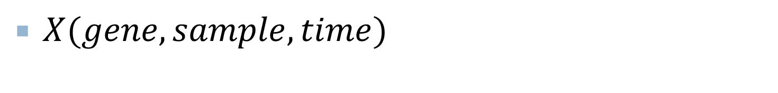
3-way Microarray Data Analysis
$X(gene, sample,time)$

Slide 26
What is ML for Big Data?
Pragmatic view
  Small Data: Naïve algorithms are feasible
  Medium Data: Feasibly processed on one machine
  Big Data: Does not fit on one machine
Complex relational data
  Analysis of pairwise/higher order interactions between entities

Slide 27
Supervised Learning
Classification

Slide 28
Classification: Logistic Regression
Feature 1 | Feature 2 | Feature 3 | Feature 4 | Class
5.1 | 4.3 | 2.1 | 0.3 | 0
5.7 | 3.5 | 3.2 | 0.8 | 0
3.4 | 5.2 | 0.4 | 0.6 | 1
X1 | X2 | X3 | X4 | c
$$c≈f(w_{1}x_{1}+w_{2}x_{2}+…+w_{N}x_{N})$$

Slide 29

Classification in the Large Scale
Ad Prediction on a Cluster of 1000 Machines
what is the probability that a given ad will be clicked given some context?
A Reliable Effective Terascale Linear Learning System, Agarwal et.al. 2012
Features = 16 M
3TB Entries
1000 Machines
Number of Examples
17 Billion

Slide 30
Algorithm
On each node use online learning independently to find a parameter vector.
Use AllReduce to average the weights.
On each node, compute the sum of the gradient for each example.
AllReduce to add the gradients at each node.
Use L-BFGS to update the weight vector, goto 3

Slide 31
Unsupervised Learning
Clustering
Dimensionality Reduction
Visualization

Slide 32
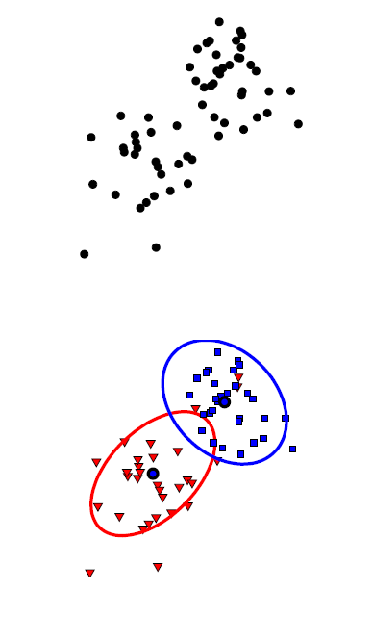
Clustering

Slide 33
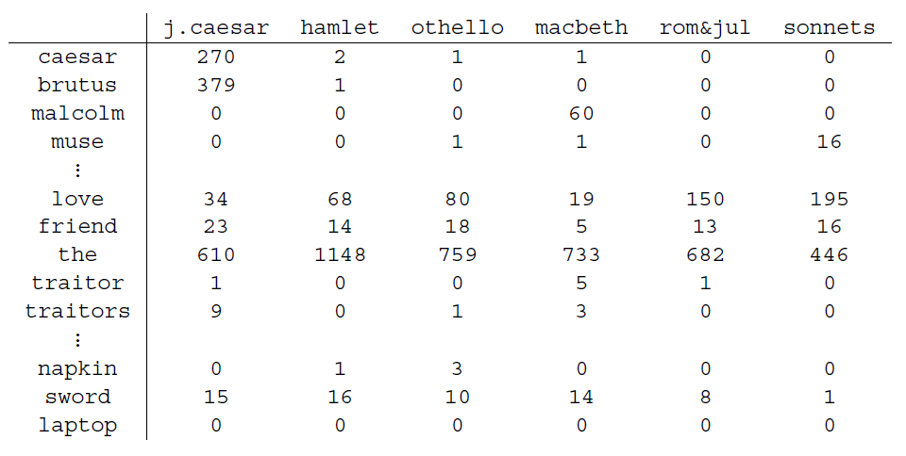
Dimensionality Reduction
Terms-Documents

Slide 34
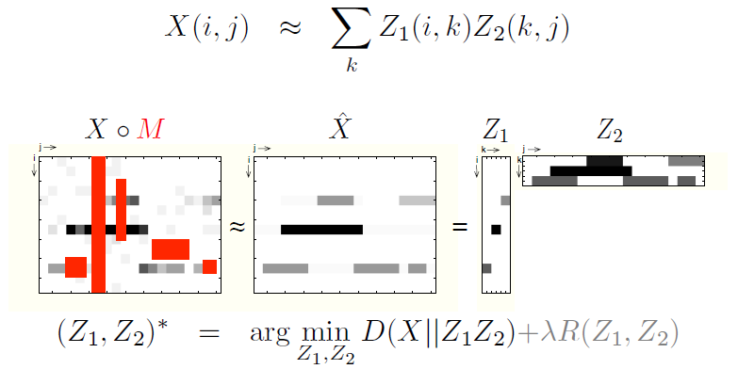
Matrix Factorizations

Slide 35
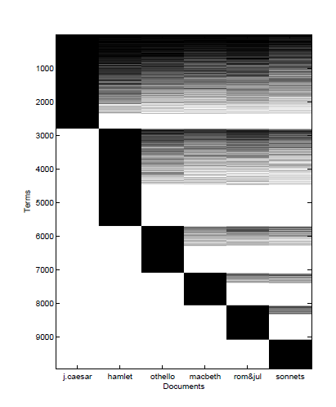
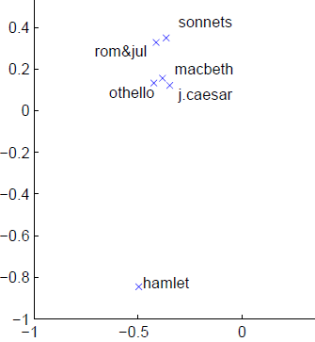
Term Document Matrix

Slide 36
Probabilistic Approach to Machine Learning
Probability Theory
  Probability theory is nothing but common sense reduced to calculation – P. Laplace
Graphical Models, Probabilistic Expert Systems
Time Series
  Example: Network flow classification

Slide 37
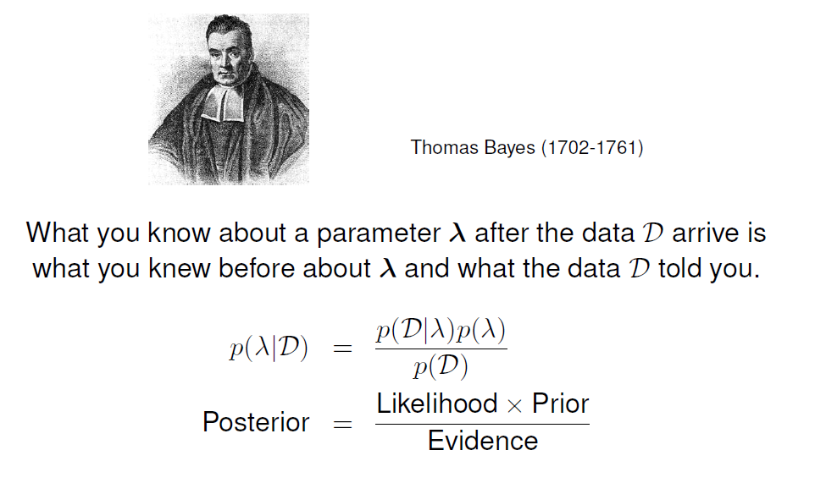
Bayes Rule

Slide 38
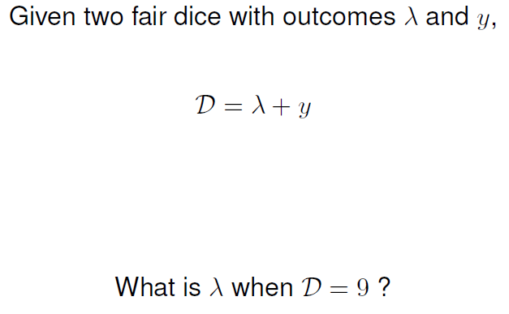
Two dice

Slide 39
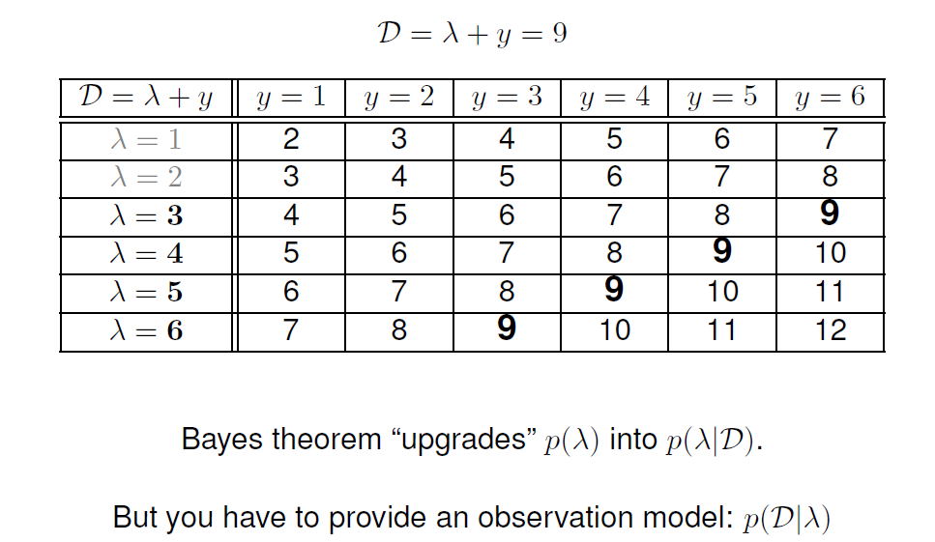
Simple Inference Example

Slide 40
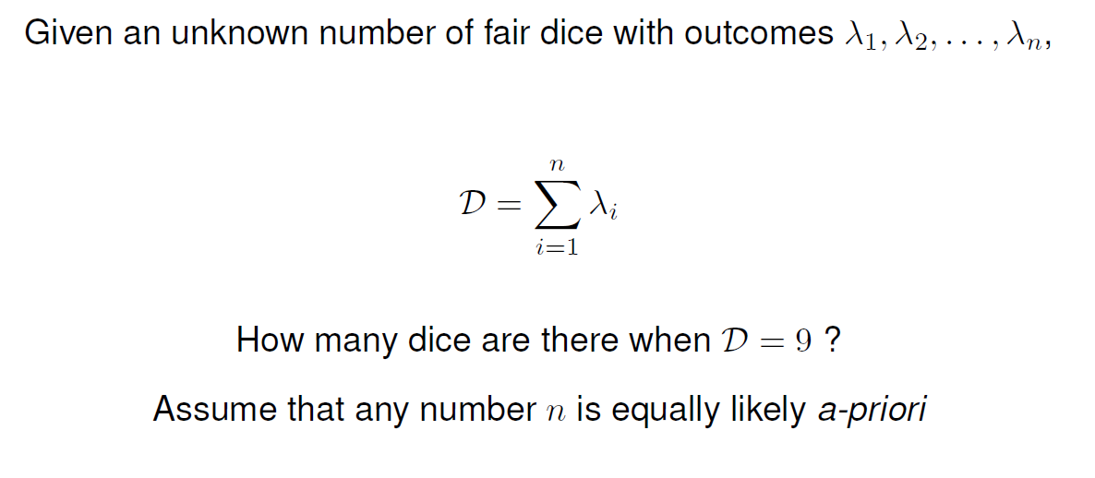

Slide 41
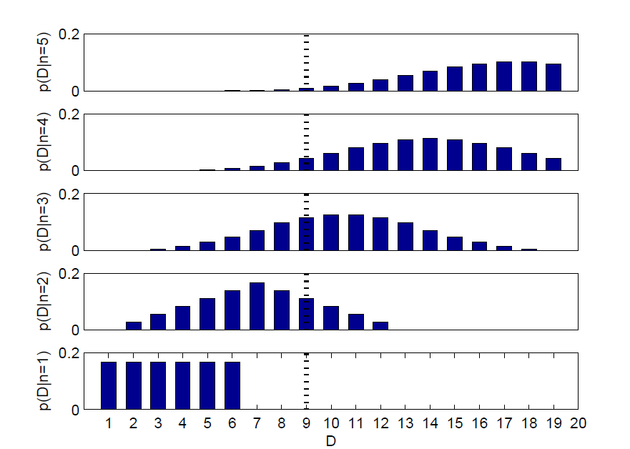

Slide 42
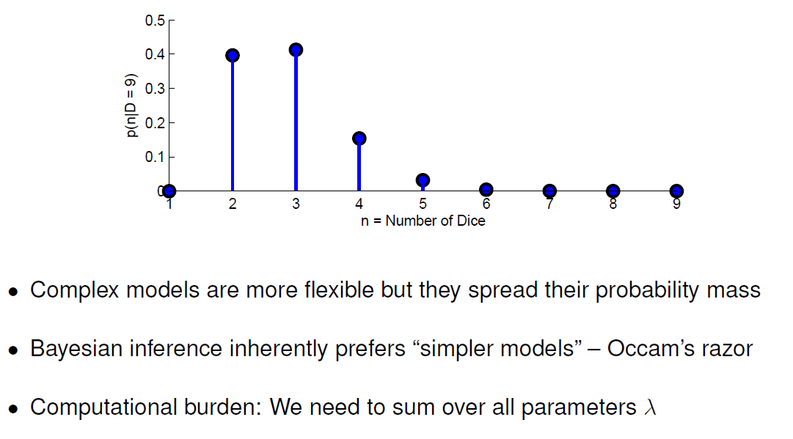

Slide 43
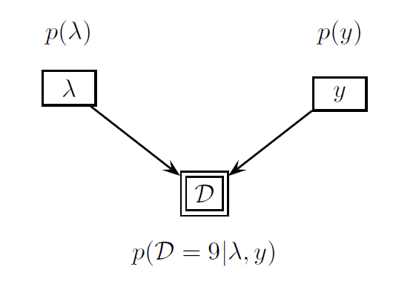
Graphical Models

Slide 44
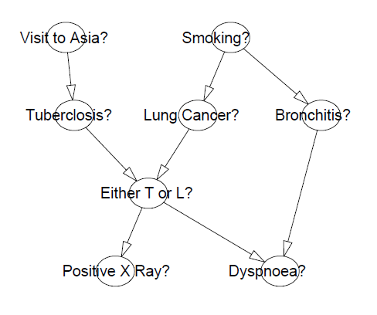
Example: Medical Expert Systems

Slide 45
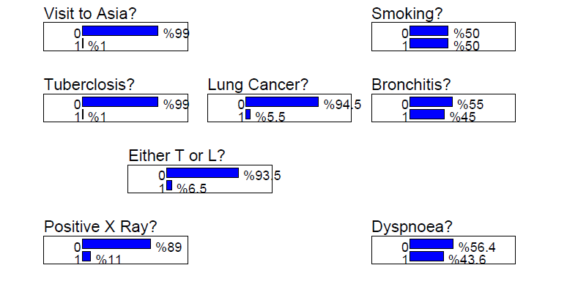

Slide 46
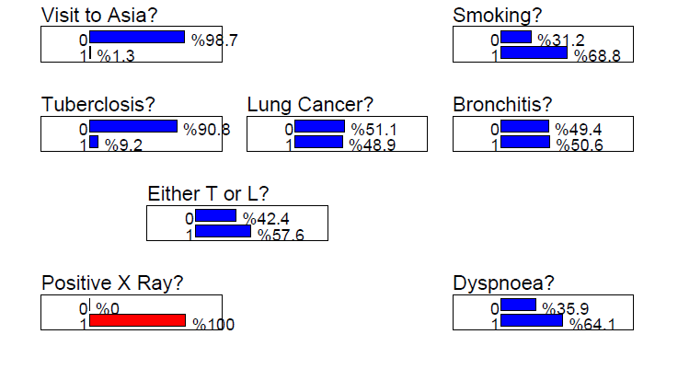

Slide 47
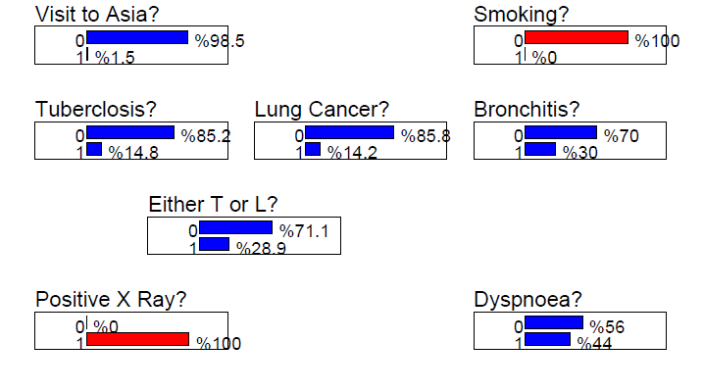

Slide 48
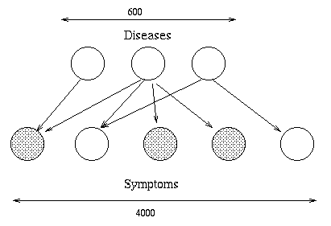
QMR-DT

Slide 49
Time Series

Slide 50
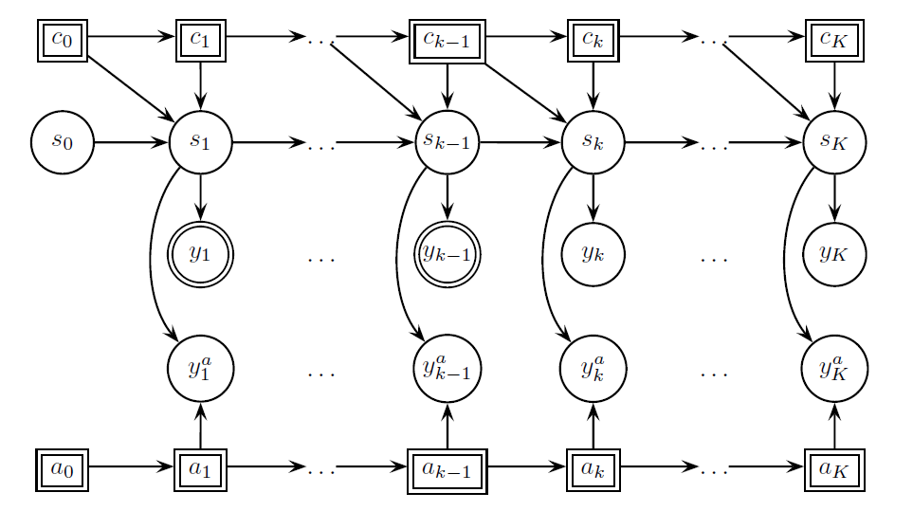
Time Series, Hidden Markov Models
Graphical Model Through Time

Slide 51
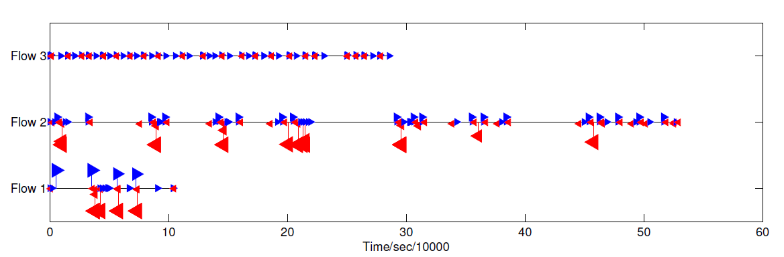
Time Series Classification
Mobile 3G Usage patterns, Monitor Applications
without Deep Packet Inspection (DPI)
8 Hrs Capture, Anonymised, without Payload 1TB
Joint work Kurt, Mungan, Saygun with Ericsson/Avae FP7 Mevico

Slide 52
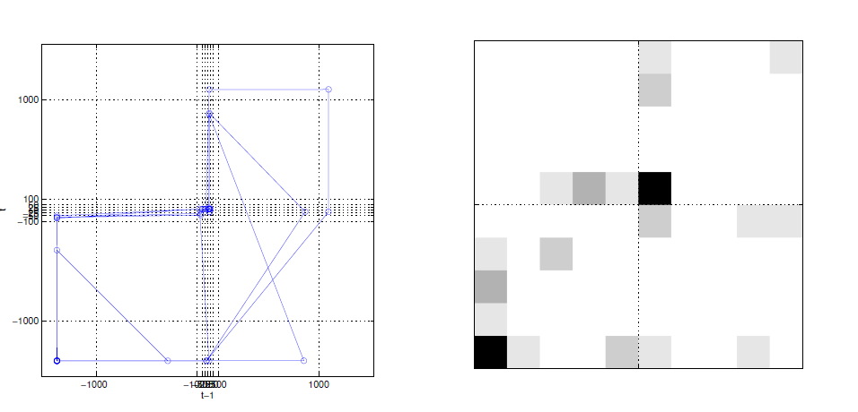
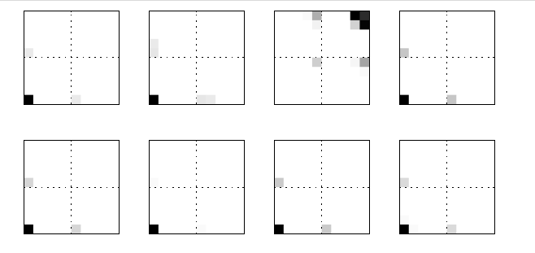
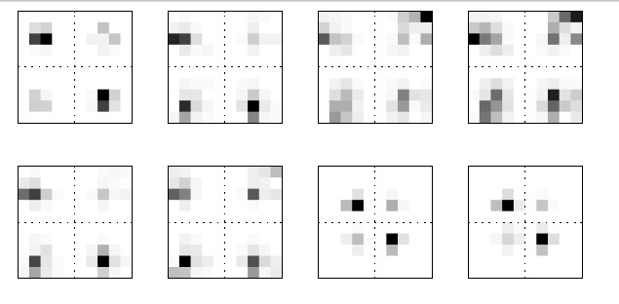
Feature Extraction
VIDEO
VIDEO2

Slide 53
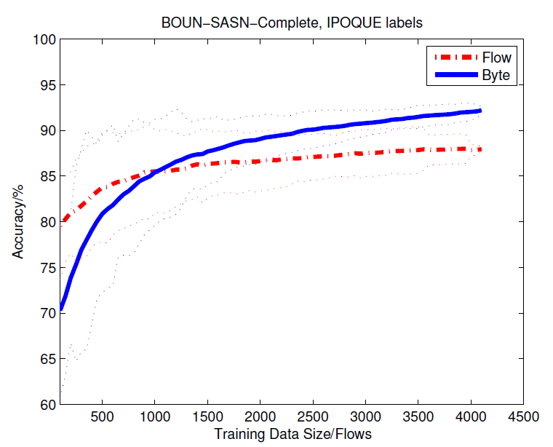
Training Data Size - Accuracy

Slide 54
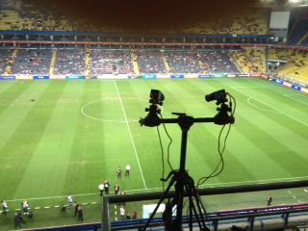
Sports Analytics
Tracking

Slide 55
Matrix and Tensor Factorizations

Slide 56
Recommendation
 | 1 | ? | 3 | 4
 | 2 | 4 | 6 | 8
 | 1.5 | 3 | ? | 6.1

Slide 57
Recommendation: Learning
 | 1 | 2 | 3 | 4
1 | 1 | ? | 3 | 4
2 | 2 | 4 | 6 | 8
1.5 | 1.5 | 3 | ? | 6.1

Slide 58
Recommendation
 | 1 | 2 | 3 | 4
1 | 1 | 2 | 3 | 4
2 | 2 | 4 | 6 | 8
1.5 | 1.5 | 3 | 4.5 | 6.1

Slide 59
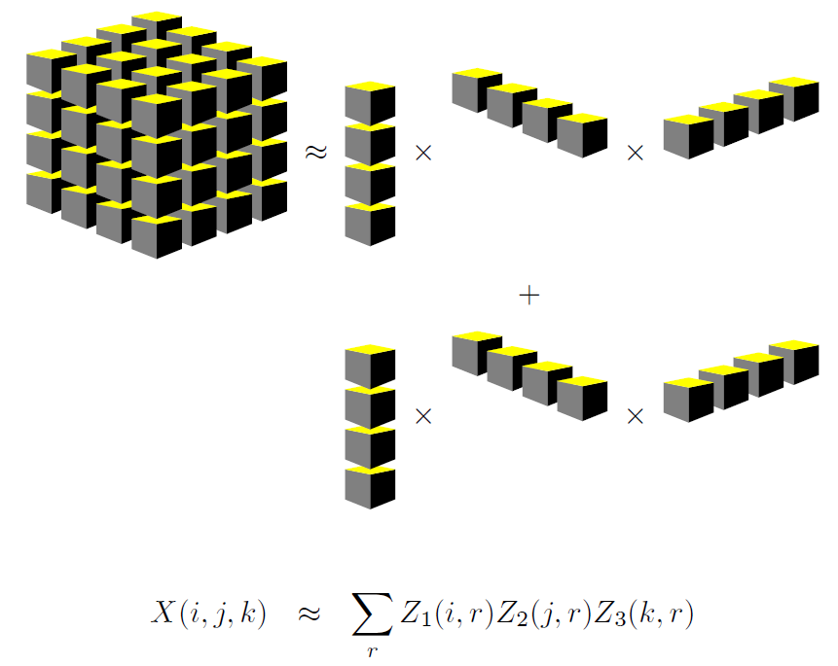
Tensor Factorization

Slide 60
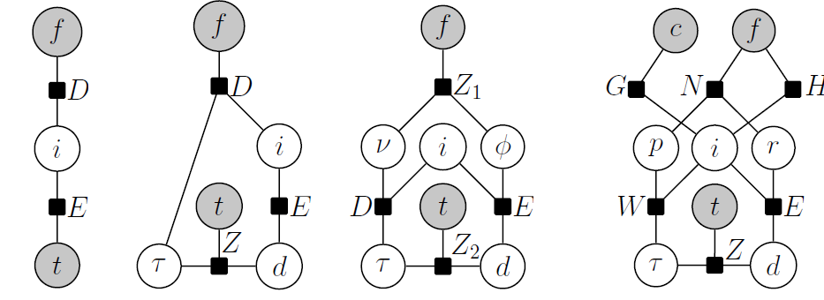
Factorization models as GM

Slide 61
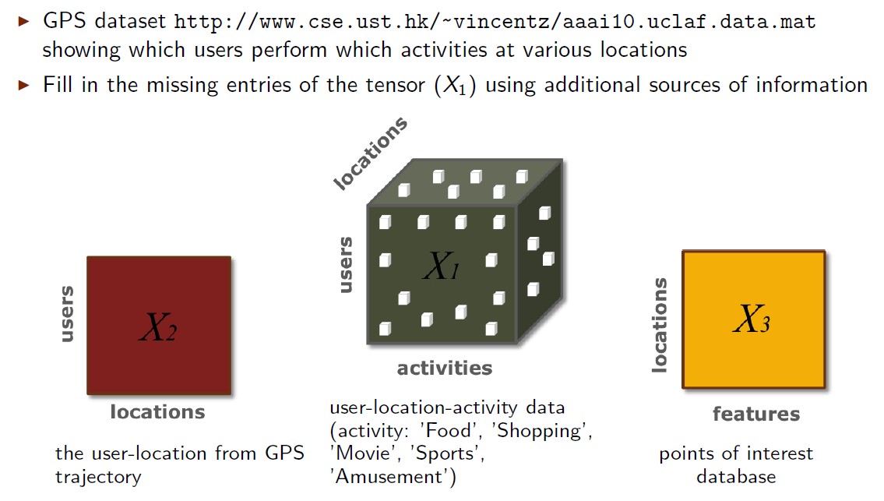
Link Prediction

Slide 62
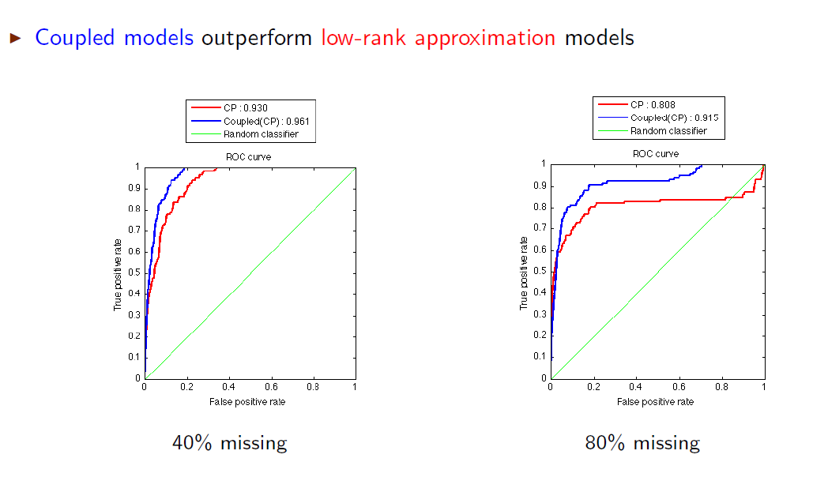
Sensor Fusion via Coupled Factorisation

Slide 63
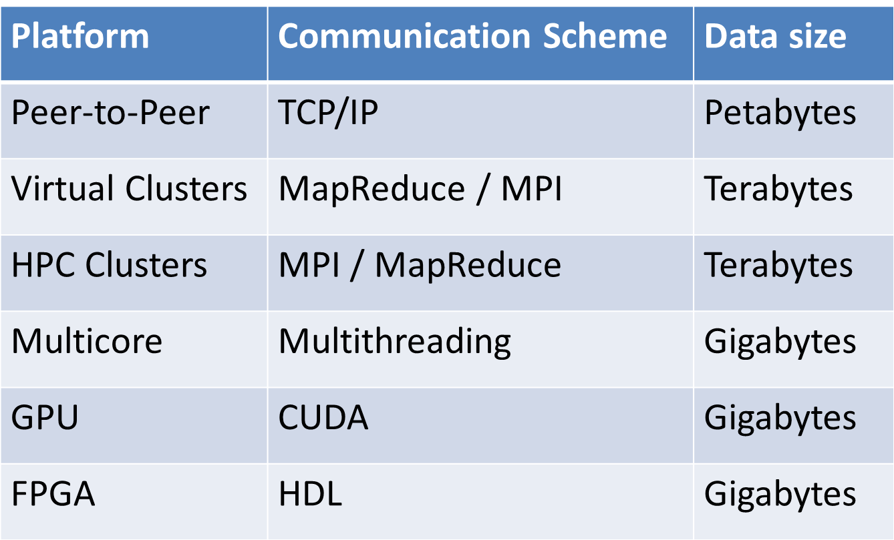
Platforms for Parallel Proc. (BBL2011)
Slide from ICML 2011 tutorial Langford et. al.

Slide 64
References
A. Gray, Analyzing Massive Datasets, Skytree, ML Company
Data Scientist: The Sexiest Job of the 21st Century (HBR)
Agarwal et. al. A Reliable Effective Terascale Linear Learning System

Slide 65
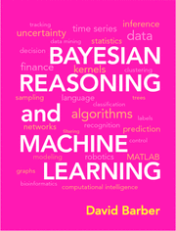
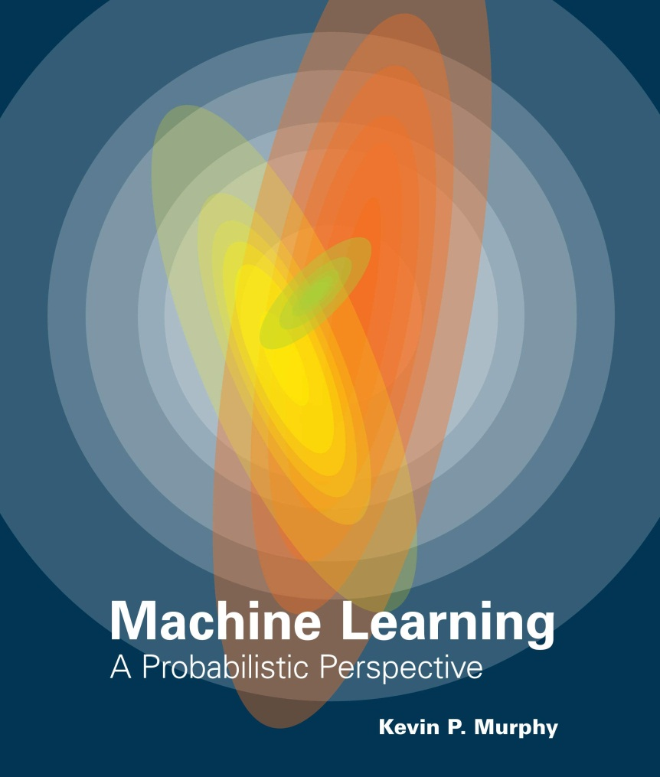
References (2012)

Slide 66

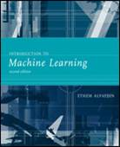
References, Basics

Slide 67
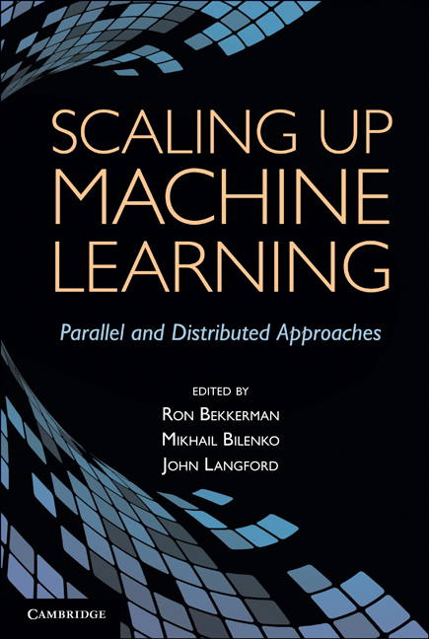
References

Slide 68
Conclusions
Data is not Knowledge
  More Data is not more Knowledge
ML for Big Data Requires a new mindset for algorithm design
Big Data is not only about entities but also about their relations and interactions
Many applications, ML provides viable solutions
New CS Education, need more Maths, Physics and Social Science Majors
Big Data = Big Potential

Slide 69

Questions

Slide 70
Crowd Sourcing
Ground Truth Labelling
Difficult but a must
Cheaters abound
Validation of labellers + qualification test
Amazon Mechanical Turk

