Slide 1
The Golden Ratio
Göktuğ Öcal
8.12.2021

Slide 2
The Golden Ratio
Math
Ratio
Fibonacci Sequence
Fibonacci and Golden Ratio
History
Great Pyramid and Parthenon
Euclid
Fibonacci
Da Vinci
Kepler

Slide 3
Math
Fibonacci Sequence, Golden Ratio, Golden Rectangle, Recurrence Relation

Slide 4
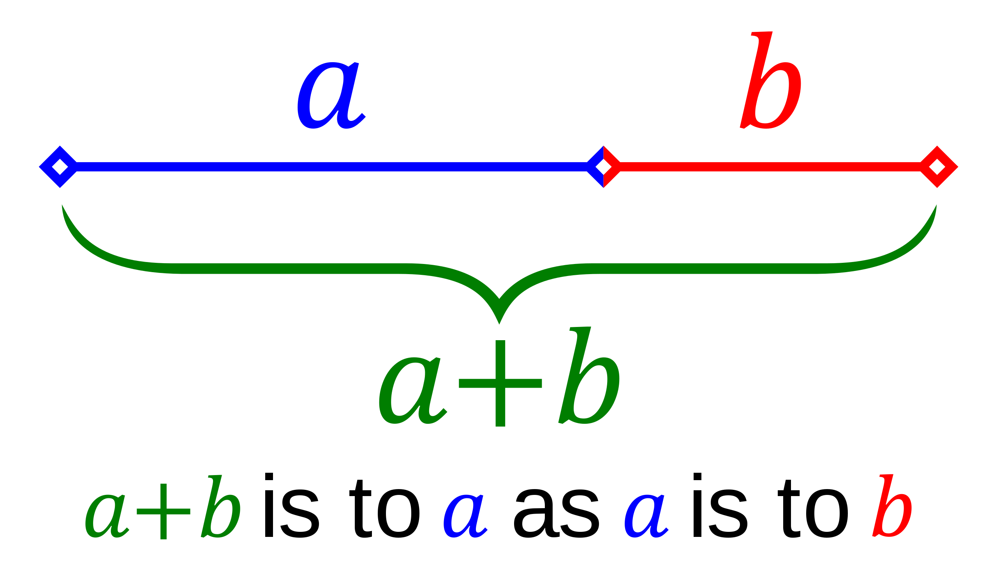
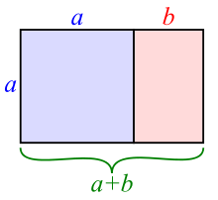
Ratio
Golden ratio is often denoted by the Greek letter $φ$ (phi).
$φ≅1.618$
Golden section, golden mean, divine proportion
$φ= \frac{1+ \sqrt{5}}{2}$, where it comes from?
$$\frac{a+b}{a}= \frac{a}{b}=φ$$
1.61803398874989484820...
$$Golden rectangle$$

Slide 5
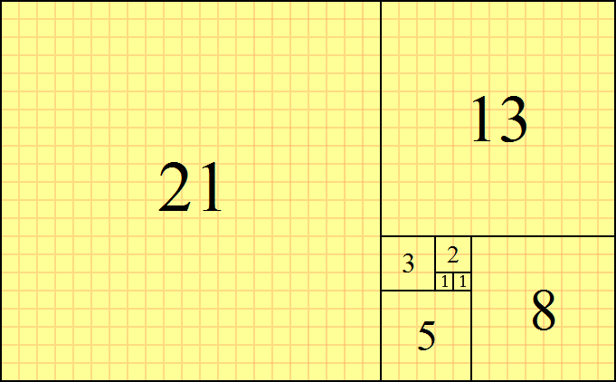
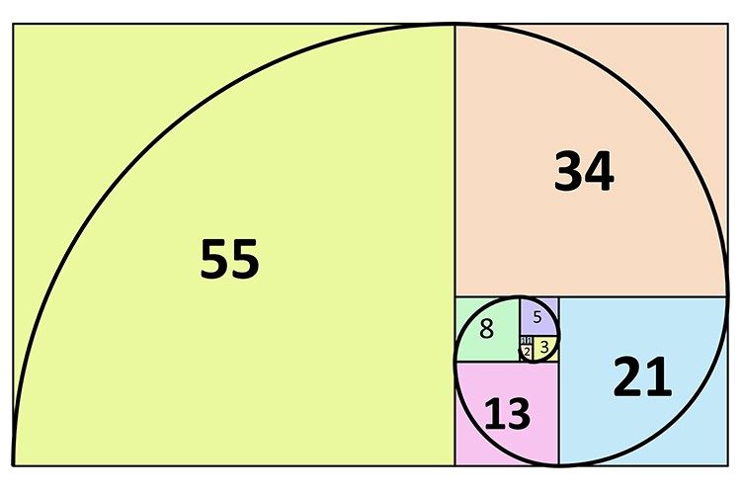
Fibonacci Sequence
$F_{0} = 1$
$F_{1} = 1$
$F_{N}=F_{N−1}+F_{N−2}$ for $n ≥ 2$
0, 1, 1, 2, 3, 5, 8, 13, 21, …
$$Fibonacci Tiling$$
$$Fibonacci Spiral$$

Slide 6
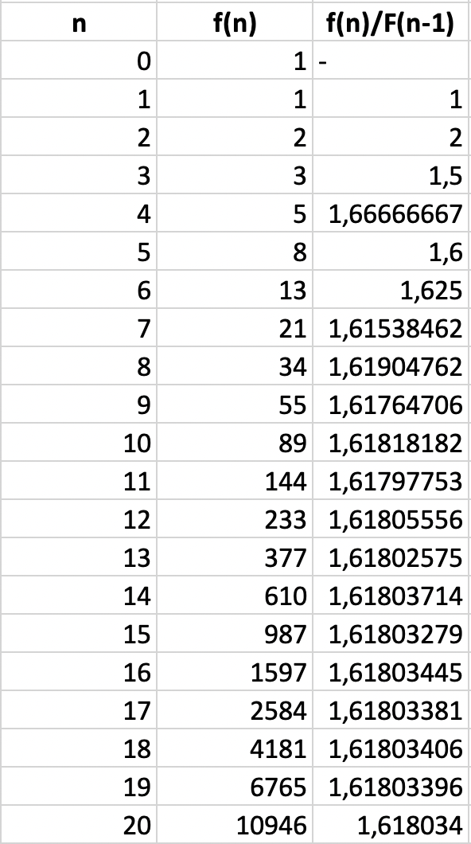
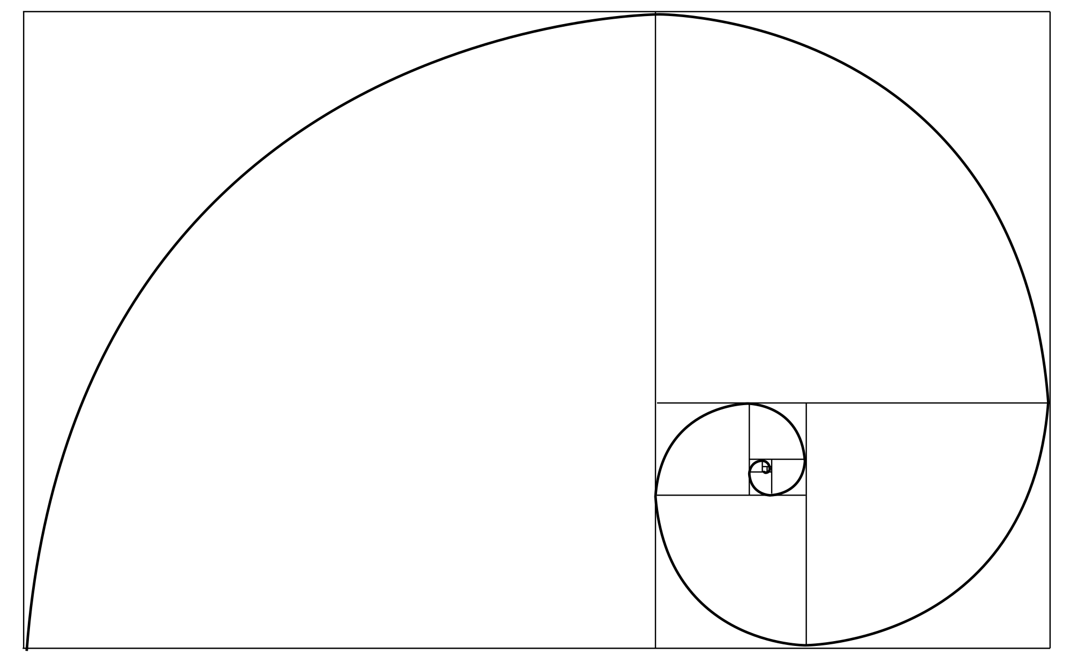
Fibonacci Sequence and Golden Ratio
$\lim_{n→∞}{\frac{F_{N}}{F_{N−1}}}=L$
$\lim_{n→∞}{\frac{F_{N}}{F_{N−1}}}=\lim_{n→∞}{\frac{F_{N+1}}{F_{N}}}=L$
$F_{N+1}=F_{N}+F_{N−1}$
$\lim_{n→∞}{\frac{F_{N+1}}{F_{N}}}=\lim_{n→∞}{\frac{F_{N}+F_{N−1}}{F_{N}}}=1+\frac{1}{L}$
$1+\frac{1}{L}=L$ , $L^{2}−L−1=0$
$L=\frac{1+\sqrt{5}}{2}=φ$

Slide 7
Fibonacci Sequence and Golden Ratio

Slide 8
History
Great Pyramids, Parthenon, Phidias, Euclid, Fibonacci, Da Vinci, Kepler, Phi

Slide 9
Ancient Era
Egyptians may have used both pi and phi in the design of the Great Pyramids.
Greeks are thought by some to have based the design of the Parthenon on this proportion

Slide 10
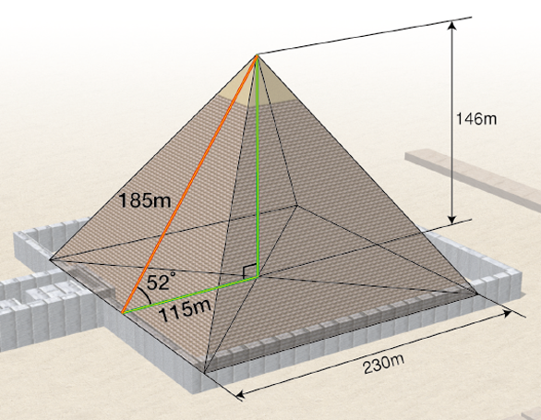
Great Pyramids
The Egyptian Great Pyramid, one of the seven wonders, constructed in 2580-2560 BC, the Golden Ratio can be found: the ratio of the slant height of pyramid to half the base dimension is 1.61804, which is extremely close to the Golden Ratio.
$$115 m = 220 cubits$$
$$146 m = 280 cubits$$
$$185 m =356 cubits$$
$$\frac{356}{220}≅1.681$$

Slide 11
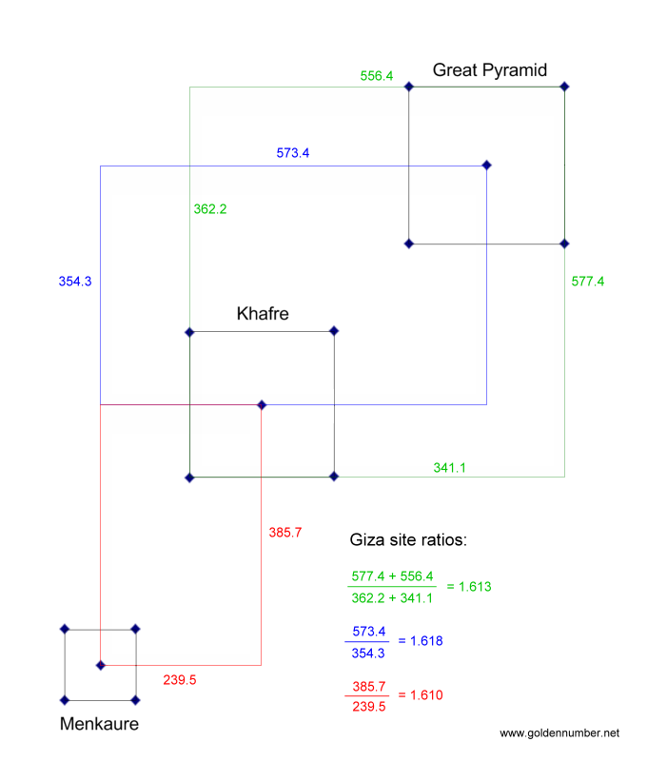
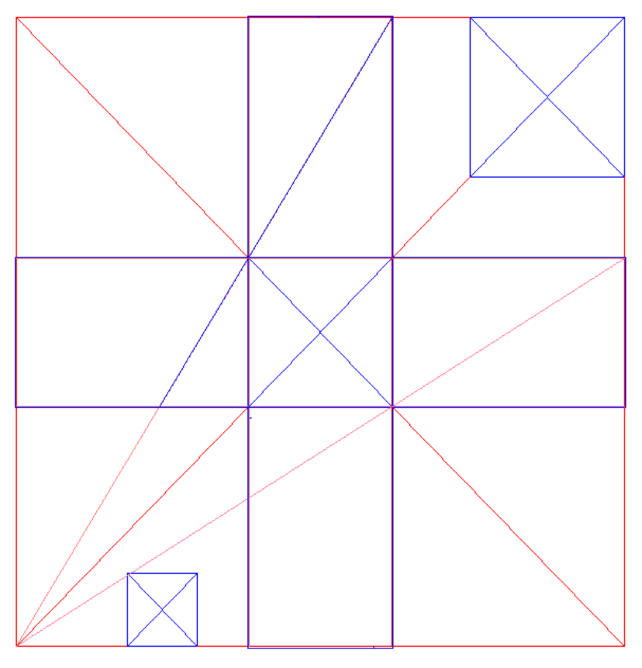
Great Pyramids

Slide 12
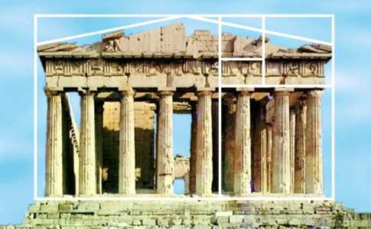
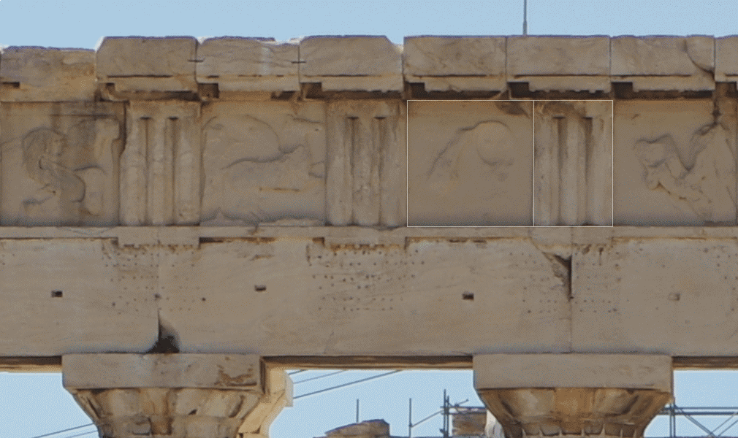
Parthenon
Phidias (500 BC – 432 BC), a Greek sculptor and mathematician, studied phi and applied golden ratio to the design of sculptures for the Parthenon.

Slide 13
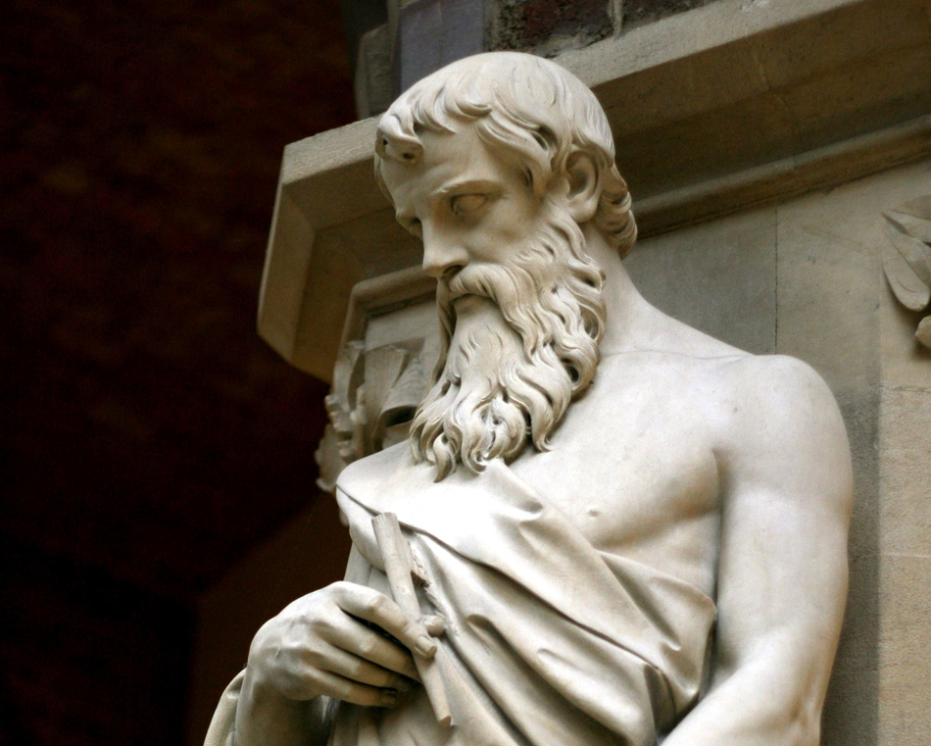
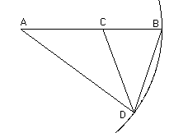
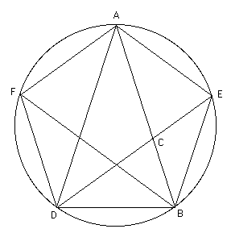
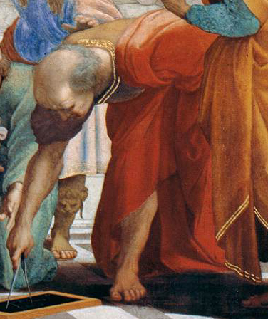
Euclid’s Elements
Euclid (365 BC – 300 BC), in “Elements” referred to dividing a line at the phi point as “dividing a line in the extreme and mean ratio.” This later gave rise to the use of the term mean in the golden mean.
He also linked this number to the construction of a pentagram.

Slide 14
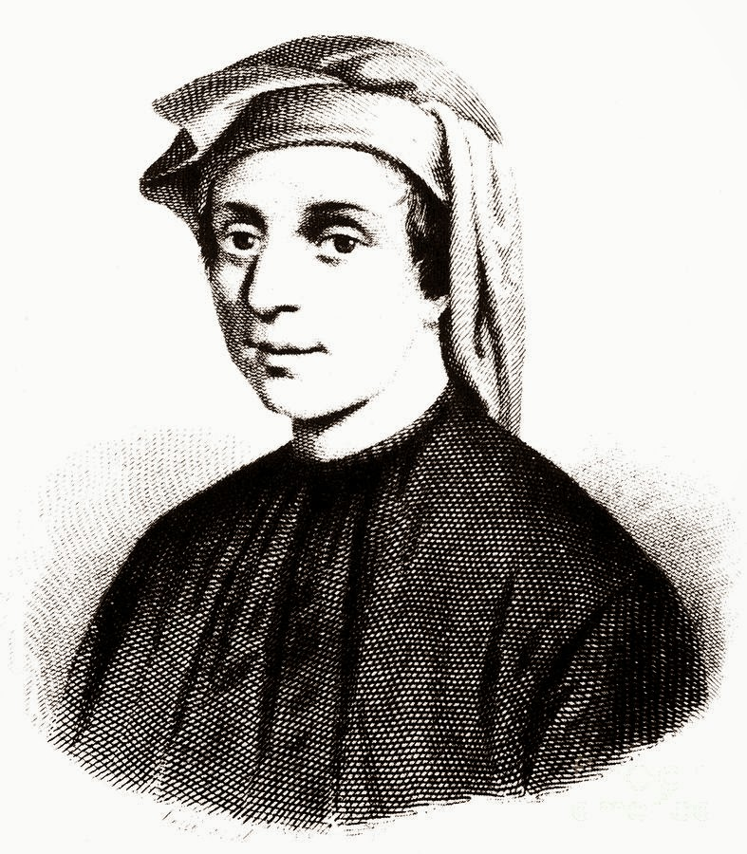
Leonard Fibonacci
Fibonacci sequence is named after Leonardo Pisano Bonacci (aka Bigollo) of Pisa, an Italian born in 1170 , who later became known as Leonardo Fibonacci.
He may not have realized that his sequence of numbers had a connection with Phi but Fibonacci is responsible for gets the closest to achieving this.

Slide 15
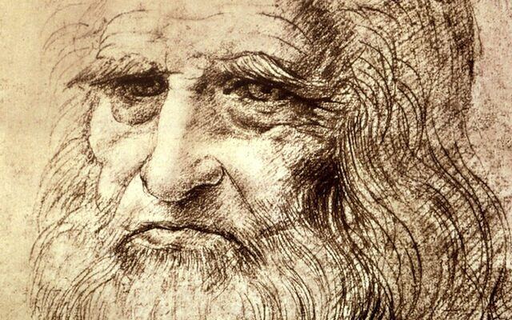
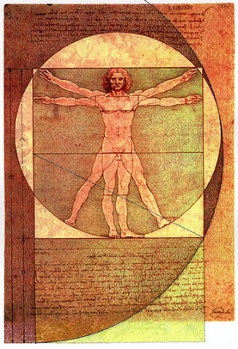
Leonardo Da Vinci
In about 1487, Leonardo da Vinci created the famous Vitruvian Man, in which he drew a picture of a man’s body that has measurements that approximate the Golden Ratio.
In 1509 Da Vinci contributed to a three volume work, called The Divine Proportion written by Franciscan friar and mathematician Fra Luca Pacioli.
He believed that the properties of this special number were related to and expressions of certain characteristics of God
https://issuu.com/s.c.williams-library/docs/de_divina_proportione

Slide 16
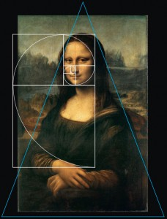
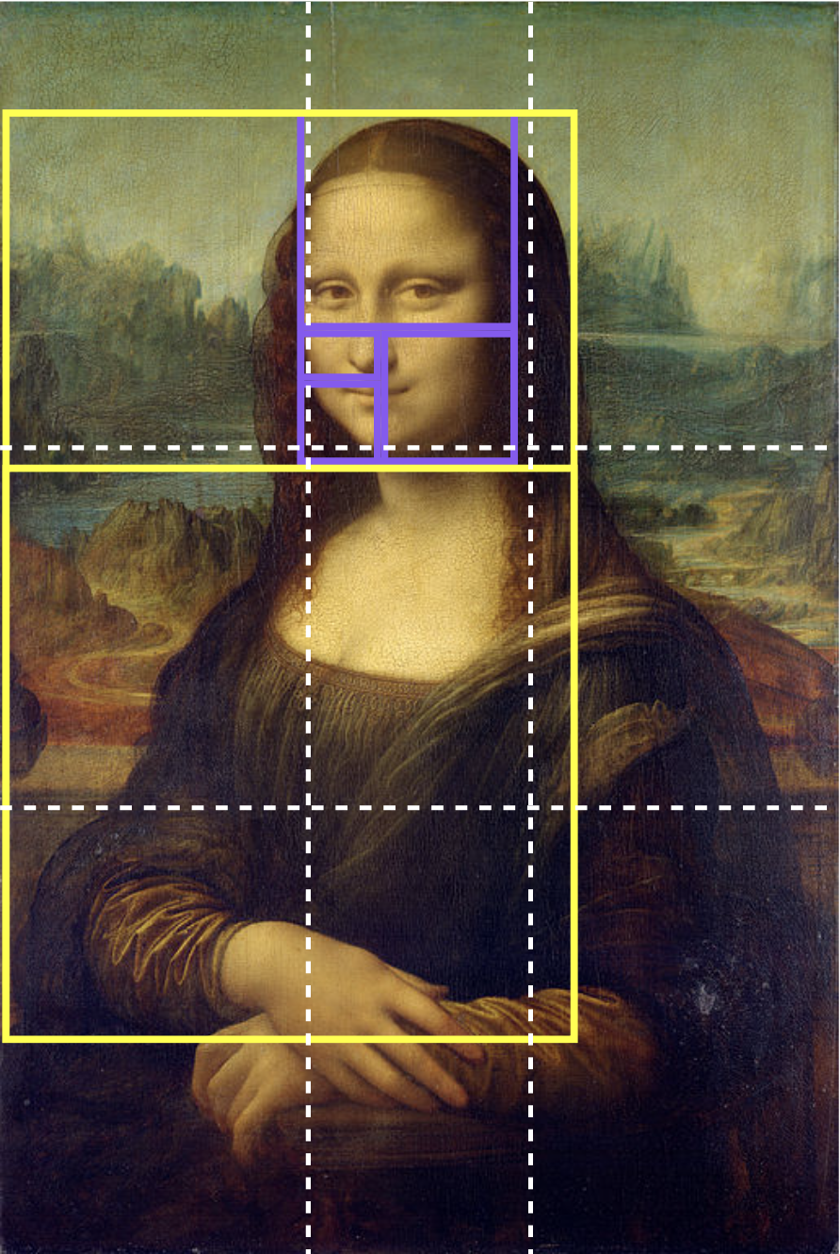
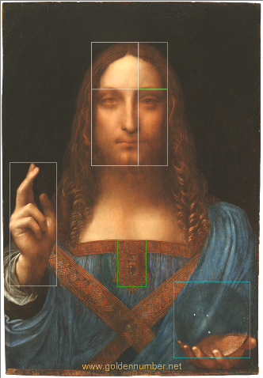
Leonardo Da Vinci

Slide 17
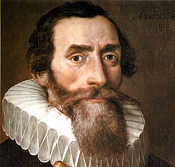
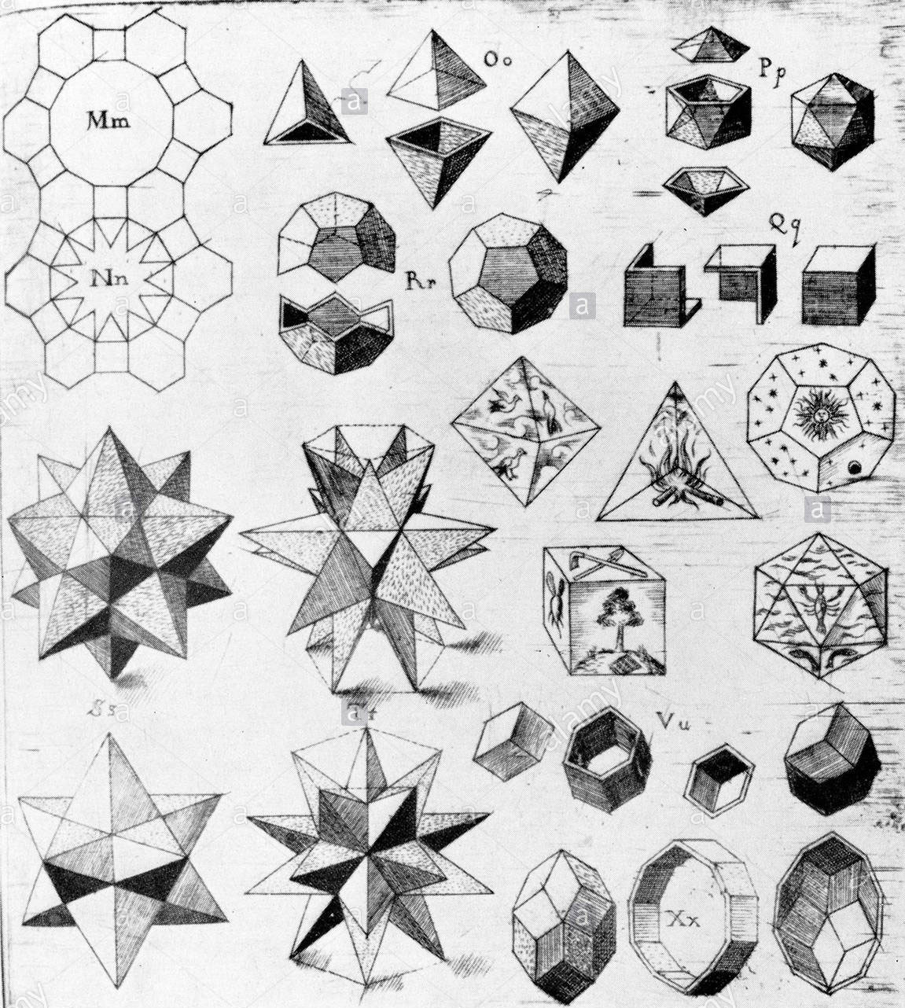
Johannes Kepler
German astronomer and mathematician (1571–1630).
In his work World Harmonic, "Harmonices Mundi" (1619), Kepler speaks in connection with music of the spheres and the ratios of tone intervals about the golden ratio, the "proportio divina".
Kepler also formulates the approximation of the golden ratio by the proportions of consecutive Fibonacci numbers.

Slide 18
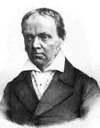
The Term Golden
It is believed that Martin Ohm (1792–1872) was the first person to use the term “golden” to describe the golden ratio.
Notes:
Martin Ohm (May 6, 1792 in Erlangen – April 1, 1872 in Berlin) was a German mathematician and a younger brother of physicist Georg Ohm.

Slide 19
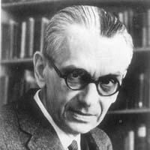
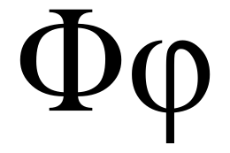
Phi
Mark Barr used the Greek letter phi (Φ) to designate the golden ratio in commemoration of the Greek sculptor Phidias.
Notes:
He was an electrical engineer, physicist, inventor

Slide 20
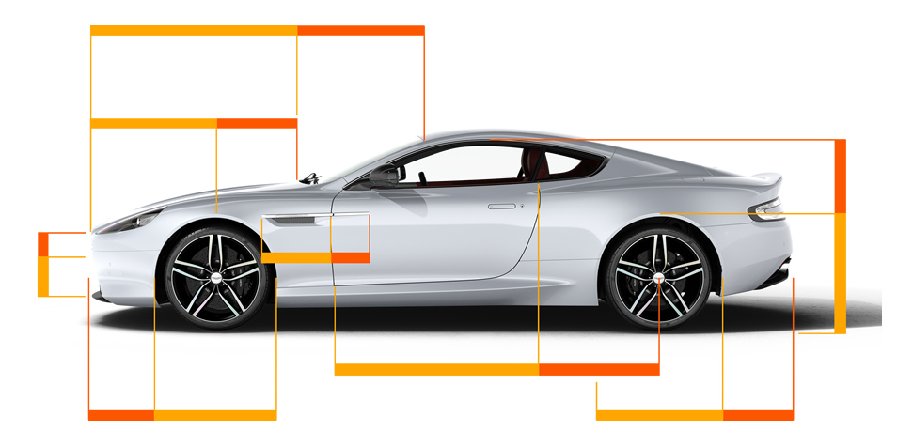
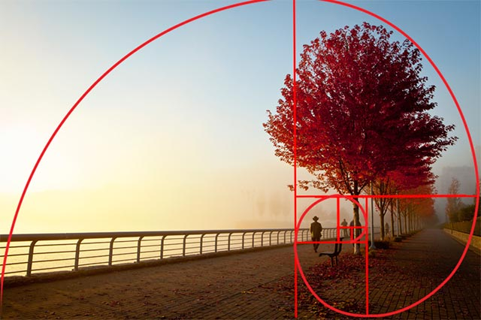
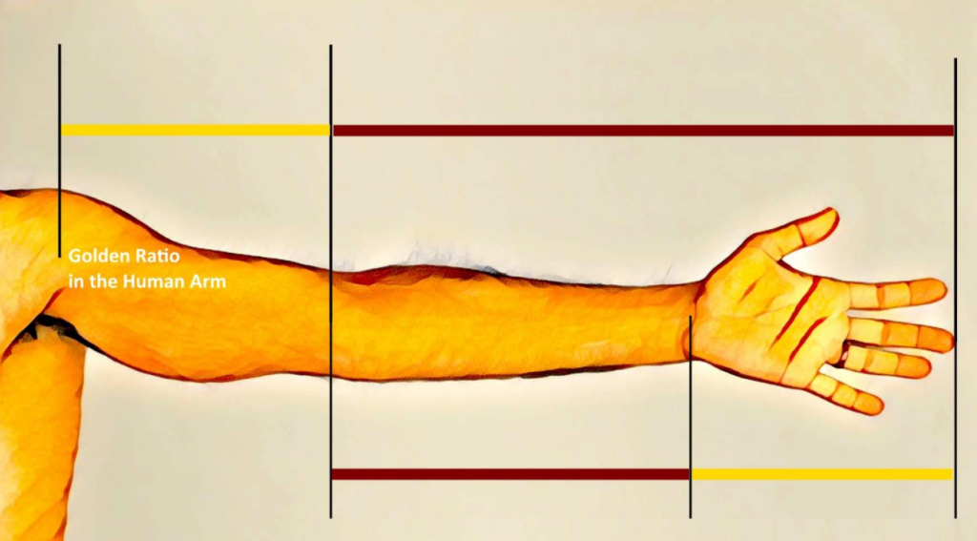
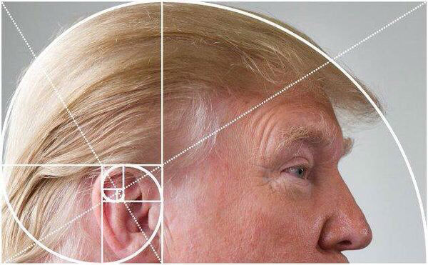
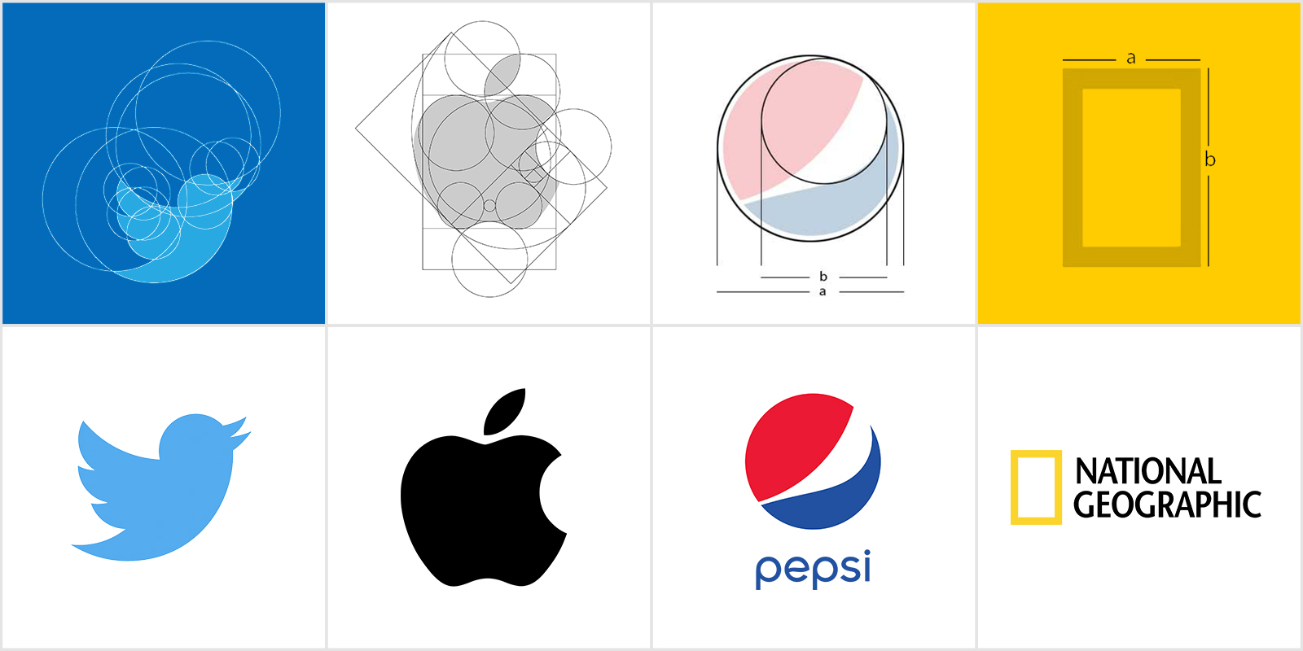
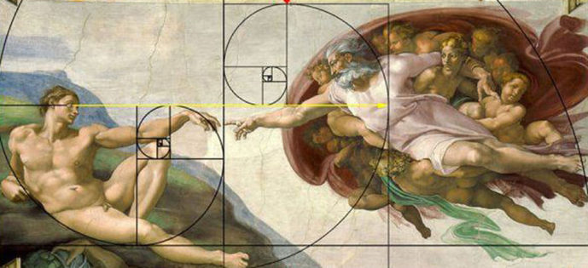

Slide 21
Sources
https://www.goldennumber.net/golden-ratio-history/
https://mathshistory.st-andrews.ac.uk/HistTopics/Golden_ratio/
https://goldenratioandphi.weebly.com/the-golden-ratio-in-history.html
https://www.projectrhea.org/rhea/index.php/Golden_Ratio:_History
https://en.wikipedia.org/wiki/List_of_works_designed_with_the_golden_ratio
https://mathworld.wolfram.com/GoldenRatio.html
https://www.cs.cornell.edu/courses/cs2110/2016fa/L23-Fibonacci/cs2110Fibonacci.pdf

Slide 22
Thanks!

