Slide 1


Random Number Generation
CMPE220 DISCRETE COMPUTATIONAL STRUCTURES
ANIL DOYRAN / 2020700051
20.01.2021

Slide 2
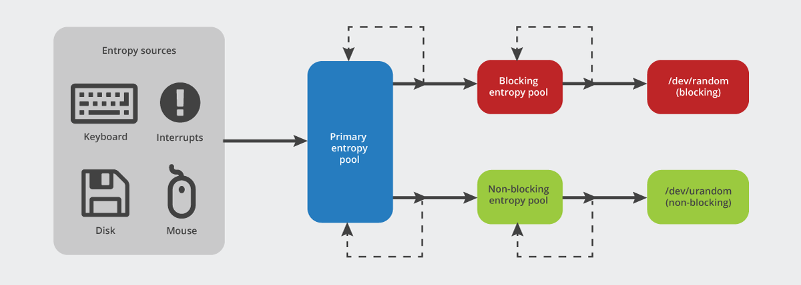
Entropy Source
Reference: https://blog.cloudflare.com/ensuring-randomness-with-linuxs-random-number-generator/

Slide 3
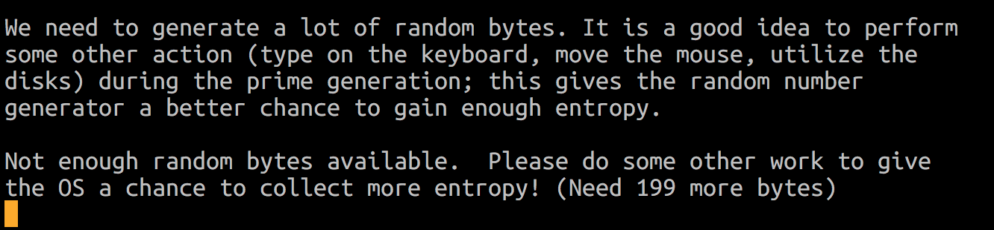
Entropy Source
Reference: https://ensan.net/wp-content/uploads/2020/05/random-bytes-entropy.png

Slide 4
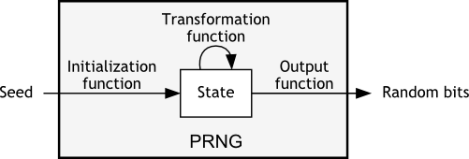
PRNG (Pseudorandom Number Generator)
Reference: https://pit-claudel.fr/clement/blog/how-random-is-pseudo-random-testing-pseudo-random-number-generators-and-measuring-randomness/

Slide 5
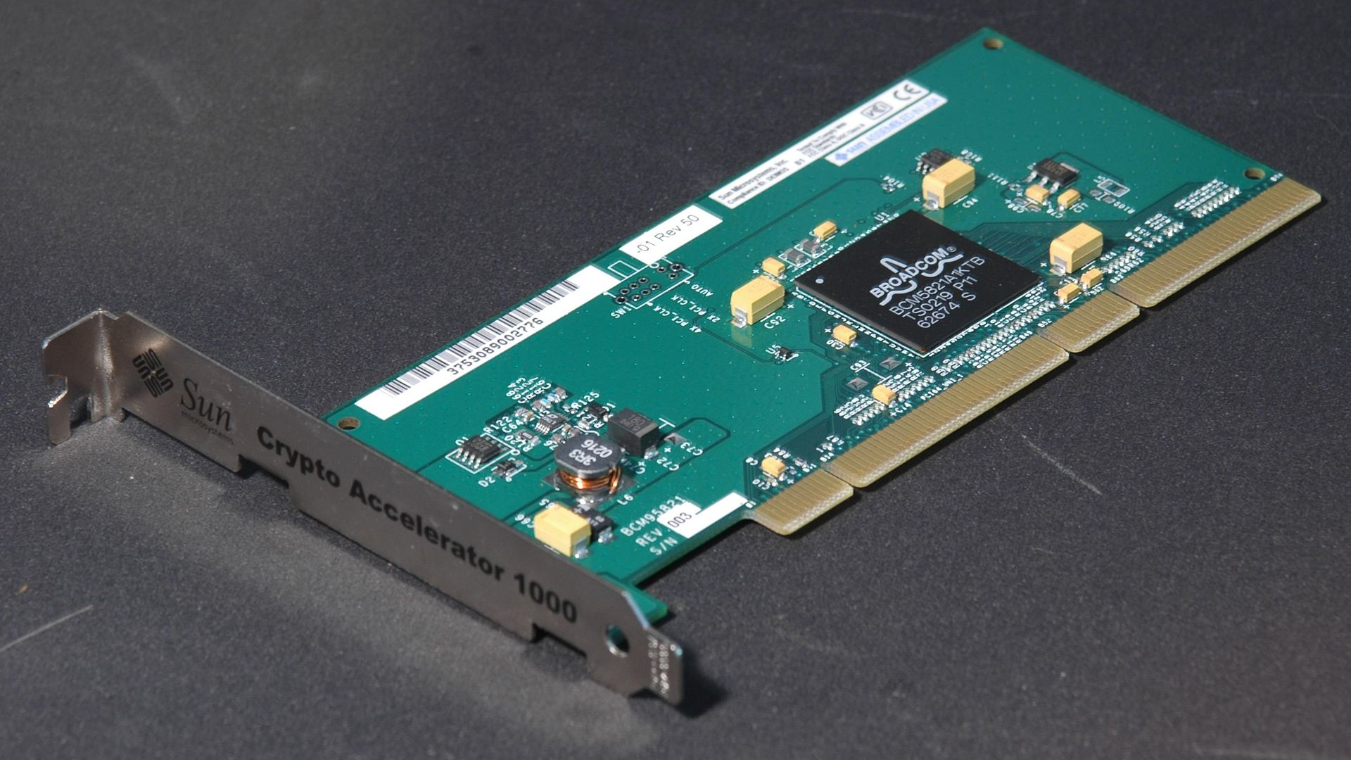
TRNG (True Random Number Generator)
TLS Accelerator Computer Card uses a hardware random number generator to generate cryptographic keys to encrypt data sent over computer networks
Reference: https://en.wikipedia.org/wiki/Hardware_random_number_generator#/media/File:Sun-crypto-accelerator-1000.jpg

Slide 6
PRNG vs. TRNG
Characteristic | PRNG | TRNG
Efficiency | Excellent | Poor
Determinism | Deterministic | Nondeterministic
Periodicity | Periodic | Aperiodic

Slide 7
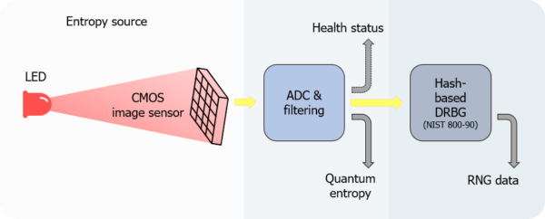
QRNG (Quantum Random Number Generator)
Reference: https://www.idquantique.com/random-number-generation/products/quantis-qrng-chip/

Slide 8
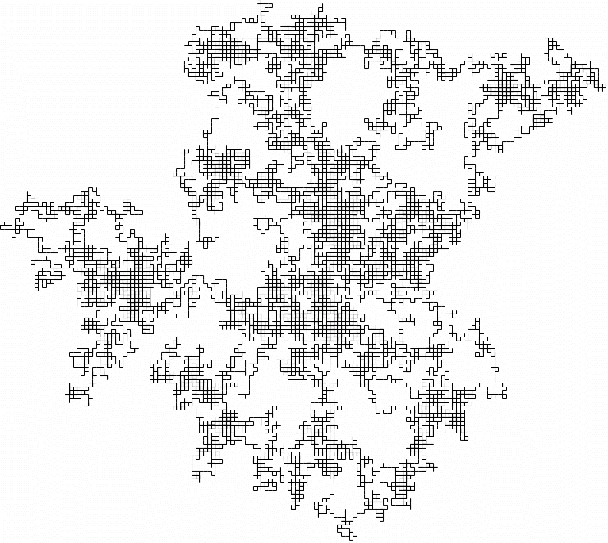
How to measure the degree of randomness ?
https://nvlpubs.nist.gov/nistpubs/Legacy/SP/nistspecialpublication800-22r1a.pdf

