Slide 1
Georg Cantor
24.11.2021
Nazire Ata
Presentation for Cmpe220

Slide 2
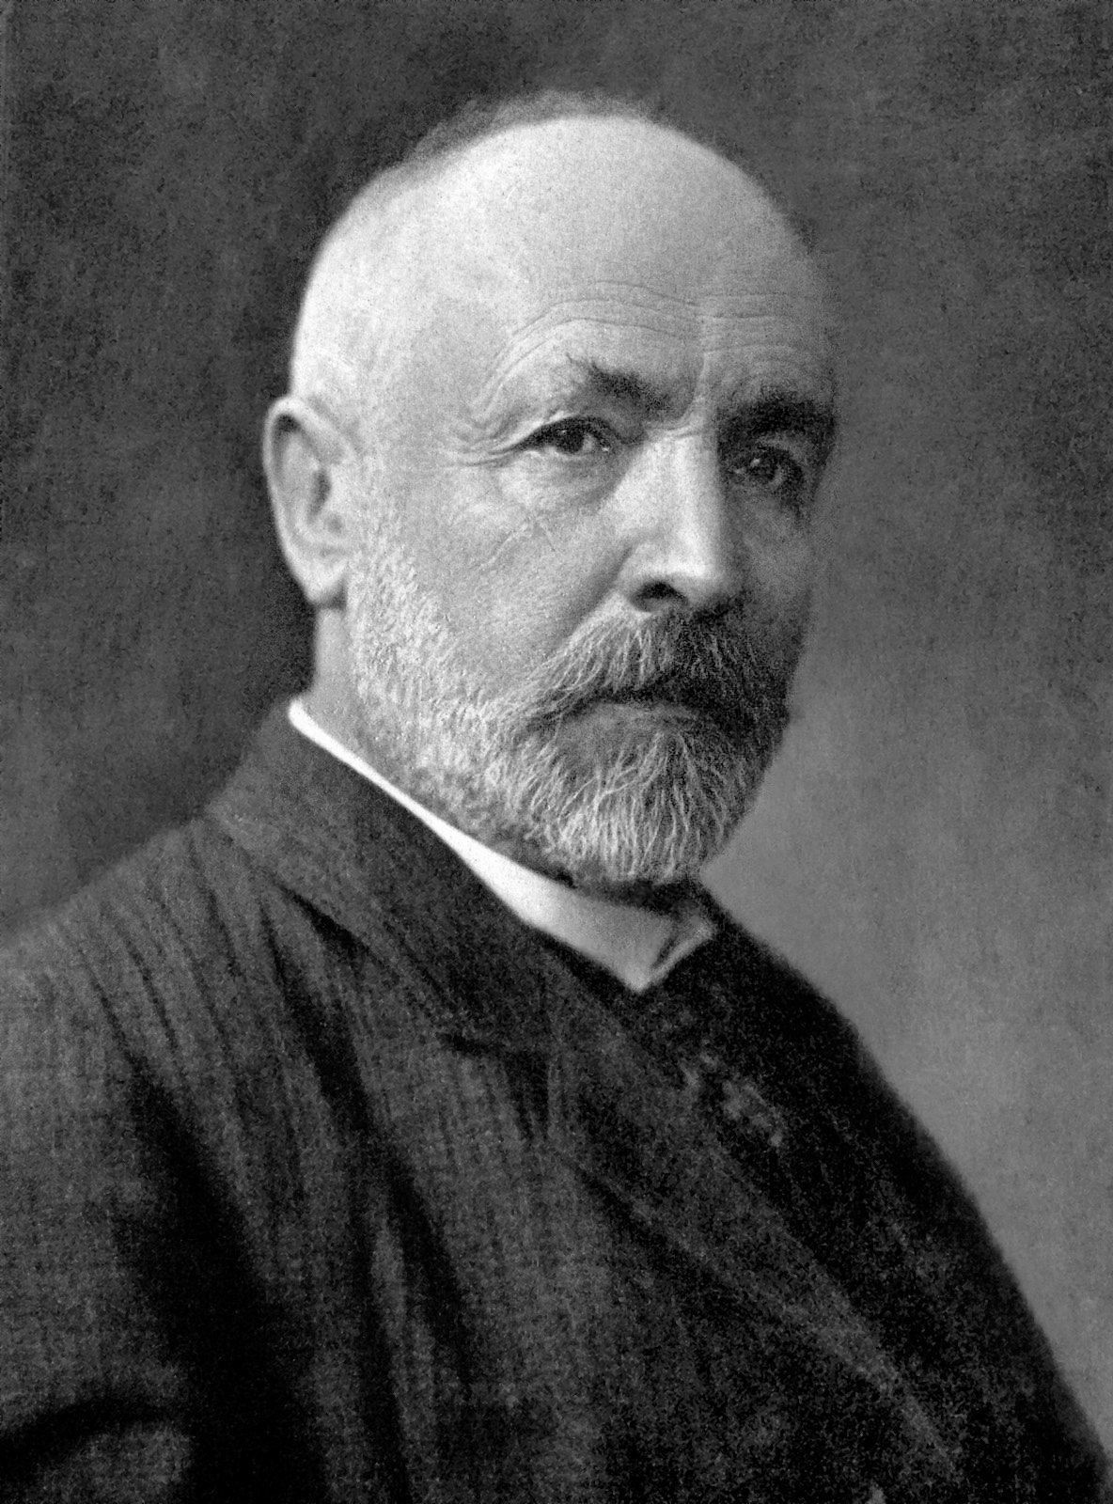
Early lıfe
Born in 1845 in Saint Petersburg, Russian Empire
Moved to Germany in 1856
Graduated from Realschule Darmstadt in 1860
Notes:
His mother was from a family of musicians and his father was a merchant

Slide 3
Early Educatıon
Höhere Gewerbeschule Darmstadt (now TU Darmstadt)
Briefly attended ETH Zürich in 1862
In 1863, transferred to University of Berlin
  Attended lectures by Leopold Kronecker, Ernst Kummer and Karl Weierstrass.
He received his doctorate degree in 1867
Notes:
He briefly attended university of zurich but then transferred to Humboldt University of berlin
Weierstrass is the father of modern analysis
After one semester at University of Göttingen, he received his doctorate

Slide 4
career
Spent all his career at the University of Halle
  Lecturer in 1869, assistant professor in 1872, full professor in 1879
Wanted a chair in a more prestigious university but got declined by Kronecker.
Wrote for Acta Mathematica for some time, then was asked to withdraw his paper due to the philosophical nature of his work.
Notes:
After a little time of teaching in a girls school in Berlin
Although it was a success to become a full professor at the age of thirty-four, he was not satisfied because he wanted a chair
Withdraw his paper due to philosophical nature and new terminology. He was ahead of his time.

Slide 5
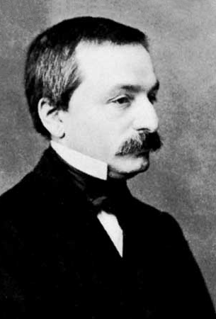
Kronecker
A respected mathematician, head of mathematics at the University of Berlin, and Cantor’s former professor.
Delayed Cantor’s first major publication and declined his applications to Berlin.
‘Corruptor of youth’, ‘scientific charlatan’, ‘renegade’

Slide 6
Depressıon
First known depression in 1884
«... I don't know when I shall return to the continuation of my scientific work. At the moment I can do absolutely nothing with it, and limit myself to the most necessary duty of my lectures; how much happier I would be to be scientifically active, if only I had the necessary mental freshness»
Recovered soon and continued his work with his diagonal argument and theorem. (Covered today)
Notes:
Every letter he wrote to Mittag-Leffler mentioned Kronecker,
Impact of the conflict with Kronecker on his sanity
Continued his work, but never really reached the level of his previous papers.

Slide 7
Later years
He was confined again in a sanatorium in 1899.
His youngest son died suddenly when he was delivering a lecture, alienating him from mathematics.
Hospitilized again in 1903.
A paper that attempted to disprove his set theory was publicly presented at the International Congress of Mathematicians.
«My beautiful proof lies all in ruins.»
Notes:
Internatinal Congress of Mathematicians. The paper was disproved in less than a day, but the humiliation still haunted Cantor.

Slide 8
death
He suffered from chronic depression, was excused from teaching, and was hospitalized in various sanatoria.
Continued lecturing on paradoxes of the set theory.
Retired in 1913
Hospitilized in a sanatorium for the last time in 1917
Had a heart attack and died in 1918
Notes:
Of the set theory. Which includes Russell’s paradox

Slide 9
Mathematıcal work
Dealt with the number theory between 1869-1873
  Proved the uniqueness of the presentation of a function by trigonometric series
Defined irrational numbers as convergent sequences of rational numbers
His work between 1874-1884 is the origin of the set theory
Notes:
Proved some of its properties

Slide 10
Set Theory
Infinite sets
  Proved that there are infinitely many possible sizes for infinite sets
Are there more than one infinities?
  Disturbed other mathematicians
Used one-to-one correspondence (last week)
Divided the infinite into the transfinite and absolute
«The essence of mathematics lies precisely in its freedom.»
Notes:
Infinity was a vague number without an end and was regarded as a topic of philosophy instead of maths before him. That’s why he was opposed this much. And the mathematicians at the time didnt like the idea of irresolvable uncertainty
One to one correspondence to define finite and infinite sets, also countably infinite and uncountable infinite sets
Transfinite is increasable in magnitude, absolute is not. An ordinal is transfinite because it can be increased to omega plus one

Slide 11
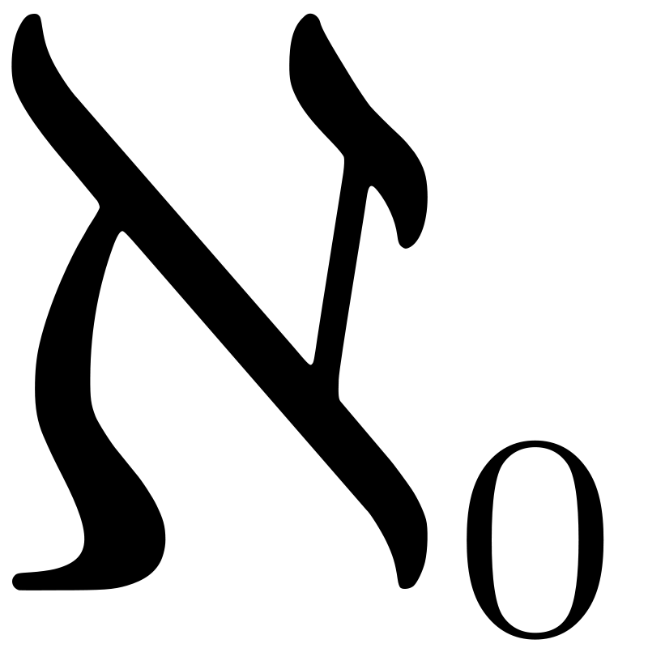
Set theory
Introduced the power set
Developed ‘cardinals’ (aleph) and ‘ordinals’ ω (omega)
Continuum hypothesis
  ‘There is no set whose cardinality is strictly between that of the integers and the real numbers.’
  Could not prove it
Cantor Set
  Infinite size, zero-length, fractional dimension
Notes:
Power set, used some corollaries to prove the Cantor theorem
Aleph and omega, which extended the arithmetics of the natural numbers
Then it was proven that this hypothesis could not be proven or disproven (after his death)

Slide 12
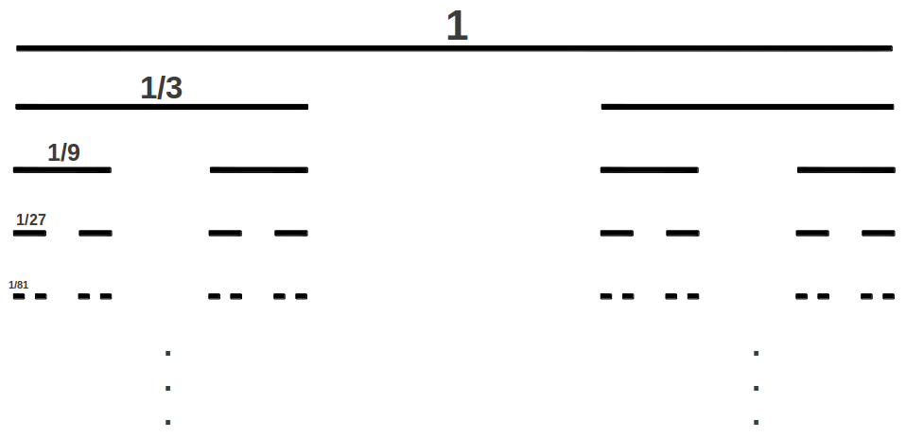
What ıs the cantor set?
Step 0
Step 1
Step 2
Step 3
Step 4
Notes:
Let us take a line (1D) and multiply its side by 2. we will have 2 of the same line.
Square will give us 4 of itself when multiplied by 2. 2 over two
Cube -> 8 of the same cube, 2 to the third
If we multiply the set in Step0 by 3, we will have 2 cantor sets. What number over 2 equals 3? Fractional dimension

Slide 13
Reference LIST
What happens at infinity? - The Cantor set. (2020, August 20). [Video]. Youtube. https://youtu.be/eSgogjYj_uw
Dauben, J. W. (1983). Georg Cantor and the Origins of Transfinite Set Theory. Scientific American, 248(6), 122–131.
Georg Cantor | Biography, Contributions, Books, & Facts. (1998). Encyclopedia Britannica. https://www.britannica.com/biography/Georg-Ferdinand-Ludwig-Philipp-Cantor
Halmos, Paul (1998)[1960]. Naive Set Theory. New York & Berlin: Springer. ISBN 3-540-90092-6
Wikipedia contributors. (2021, November 18). Georg Cantor. Wikipedia. https://en.wikipedia.org/wiki/Georg_Cantor

