Slide 1
Workshop on Teaching Style and Content
19.2.2016
Albert Ali Salah
Boğaziçi University, Dept. of Computer Engineering

Slide 2
Program
Constructive alignment
Ideas on Content
Elements of Teaching Style
TA presentations and feedback
QA

Slide 3
Constructive alignment

Slide 4
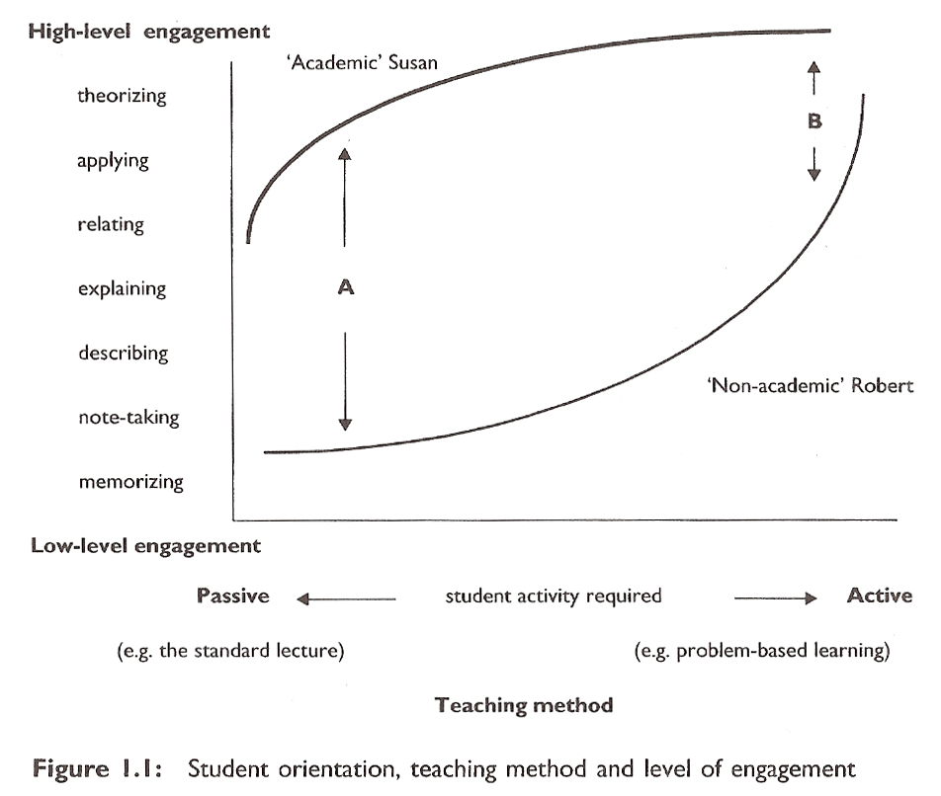
Student orientation and engagement
Three factors of student learning:
  Level of engagement
  Teaching method
  Student’s intrinsic factors

Slide 5
Learning
Approach to study
HOW
WHAT
structural
aspect
meaning
aspect
holistic
atomistic
deep
surface
whole,
preserves
structure
parts
distorts
structure
task level,
relationships
word-sentence level
assessment
BKO, October 30 2009

Slide 6
Good teaching
Reflective teaching: general principles of teaching need to be adapted to your personal style, your personal strengths, and the teaching context. You may need feedback to improve your teaching, and reflect constantly on your teaching.
Hint: You cannot change everything at once; every lecture decide on one aspect (stance, material, activation, voice projection, eye-contact, etc.) and seek to improve that dimension.
«Good teaching is getting most students to use the higher cognitive level processes that the more academic students use spontaneously.» - John Biggs

Slide 7
Surface processing
Student factors:
  Achieve a minimum passing grade
  Non-academic priorities
  Insufficient time, high workload
  Misundestanding requirements («memorization is enough»)
  Cynicism
  High anxiety
  Inability to process

Slide 8
Surface processing
Teacher factors:
  Bullet-list teaching (piecewise teaching)
  Assessing independent facts (short-answer tests, multiple choice)
  Teacher cynicism (This is boring, but we need to do it)
  Coverage at the expense of depth
  Creating unnecessary anxiety or low expectations of success («anyone who can’t do this, doesn’t belong here»)

Slide 9
Deep processing
Student factors:
  An intention to engage the material and learn (intrinsic curiosity)
  Appropriate and rich background knowledge
  Ability to focus at a high conceptual level
  Genuine preference for working conceptually, rather than with unrelated detail

Slide 10
Deep processing
Teaching factors:
  Teaching to bring out the structure of the topic or subject
  Teaching to elicit a response from the students (i.e. questioning, presenting problems, rather than teaching to expound information)
  Teaching by building on what the student already knows
  Confronting and eradicating misconceptions
  Assessing for structure rather than independent facts
  Creating a positive atmosphere, so that students are not afraid to make mistakes, and are willing to learn from these mistakes
  Emphasizing depth, rather than breadth of coverage
  Using teaching and assessment methods that are explicitly aimed for course objectives

Slide 11
The Bales learning Pyramid (1996)
Average
retention
Lecture 5%
Reading 10%
Audio visual 20%
Demonstration 30%
Discussion in group 50%
Practical exercise 75%
Handling / Teaching to others 80%

Slide 12
Constructive alignment

Slide 13
Constructive alignment
Level 1: Focus: what the student is
  The teacher sees individual differences. The responsibility of the teacher is to know and present the material well, the responsibility of the student is to absorb and learn from it. The teaching activity is not flexible; not adapted.
Level 2: Focus: what the teacher does
  The teacher seeks to transmit understanding and concepts, rather than information. «getting it across» is teacher’s responsibility now, the «blame» is the teachers as well. At this level, the teacher seeks methods of teaching, like an armoury.
Level 3: Focus: what the student does
  Focus on what the student does as process and product, and how it relates to teaching goals.

Slide 14
Focus: What the student does
Be clear about
  what it means to understand content
  what kind of activities are required to reach this understanding
Helping questions:
  How do you define the levels of understanding?
  What do the students have to do to reach the level specified?
  How can you assess that?

Slide 15
7 principles for good practice in undergrad education
Encourage contact between students and faculty.
Develop reciprocity and cooperation among students.
Use active learning techniques.
Give prompt feedback.
Emphasize time on task.
Communicate high expectations.
Respect diverse talents and ways of learning.
Chickering and Gamson, AAHE Bulletin, 1987.
BKO, October 30 2009

Slide 16
7 principles for good practice
Encourage contact between students and faculty members.
  It improves student motivation and involvement
BKO, October 30 2009

Slide 17
7 principles for good practice
2. Develop reciprocity and cooperation among students.
  Collaborative learning
  Association in groups
BKO, October 30 2009

Slide 18
7 principles for good practice
3. Encourage active learning techniques.
  Talk, write, discuss
  Relate to past knowledge/experiences.
  Apply to new situations.
BKO, October 30 2009

Slide 19
7 principles for good practice
4. Give prompt feedback.
  Constructive
  Suggestions for improvement
  Chance to reflect.
  No assessment without feedback
BKO, October 30 2009

Slide 20
7 principles for good practice
5. Emphasize time on task.
  Effective time management.
  Time investment expectations and responsibility.
BKO, October 30 2009

Slide 21
7 principles for good practice
6. Communicate high expectations.
  Expect more and you will get more.
  Day-to-day, week-in week-out expectations
BKO, October 30 2009

Slide 22
7 principles for good practice
7. Respect diverse talents and ways of learning.
  Different interests
  Different styles
BKO, October 30 2009

Slide 23
Ideas on Content

Slide 24
Teaching goals
When you teach students, they will build skills and knowledge in several stages/layers.
You should try to see the layers, and see how much each layer has accumulated.

Slide 25
Specific questions about planning student learning

Slide 26
Learning outcomes
Learning outcomes are the things your students can do after they leave your course with a good grade, that they could not do before. Stating the desired learning outcomes in advance has advantages for:
  planning the assessment in such a way that you can be sure that students who pass have truly achieved what you wanted them to learn,
  planning the course in such a way that it is likely that many students will achieve the desired learning outcomes.

Slide 27
Typical learning outcomes
No learning
  The student reads a chapter on electric circuits. In the exam she needs to recall some components. She cannot. She needs to solve a problem by using several components, and she can’t (no knowledge transfer).
Rote learning
  When studying the chapter, the student memorizes all the facts. Whe can not reall the components (retention test passed). But designing a solution to the problem is not possible, as the problem is novel (no knowledge transfer)
Meaningful learning
  The student engages the material deeply, and struggles to clarify it, establishing semantic links, understanding causes and effects. Meaningful learning provides students with the knowledge and cognitive processes they need for successful problem solving.

Slide 28
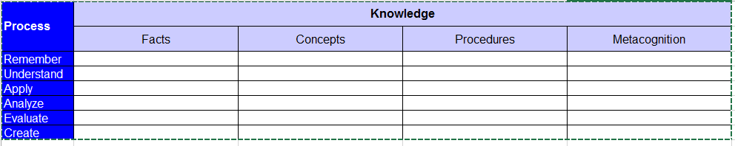
Setting «Learning Outcomes» for the class
Step 1: Formulate learning goals as sentences with the verb stating a cognitive process and a noun phrase stating the knowledge part.
Use self-chosen verbs and noun-phrases, there is no requirement to take verbs from the left column for instance.
Step 2: classify the self formulated goals: find out where they fit in the table.
Aim: find out: how ambitious, how varied are your goals?
Remembering is the least ambitious, but all the rest is built on it, of course!

Slide 29
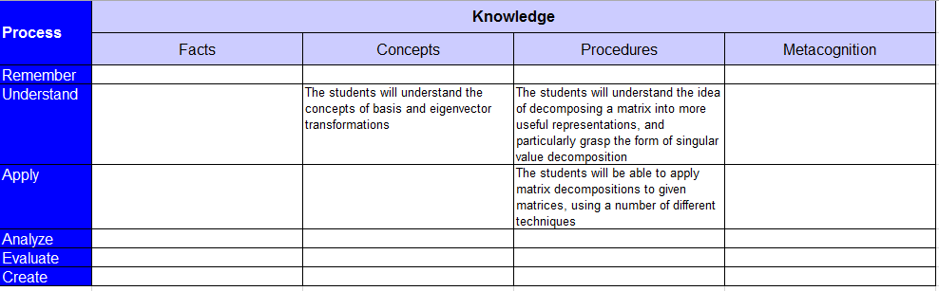
Example: Linear Algebra

Slide 30
Assessment
Answer the following question:
  What can your students do after the course, if they are successful, that they could not do before? Limit yourself to the one or two most important achievements.
The exam, project, or assessment activity should check the following:
  Are students asked to perform the actions which you have mentioned in answering the first question?
  What part of the assessment activity is devoted to testing whether students can do those things?
  Do these desired learning outcomes have enough weight in the assessment activity?

Slide 31
Assessment
The teaching activity can also be probed similarly:
  At what moment during the course are students performing the actions which you have mentioned in answering the first question?
  What part of the students’ assignments is devoted to learning to perform these actions?
  Do these desired learning outcomes have enough weight during the course?

Slide 32
Planning a single lecture
Think about «phases» in the lecture; in each phase you will have a teaching activity, which will have one main purpose (which you have planned ahead)
Take into account:
  Starting point
  Teaching aims
  Materials
  Questions to activate the students
  List of student and teacher activities, their timing, and assessment

Slide 33
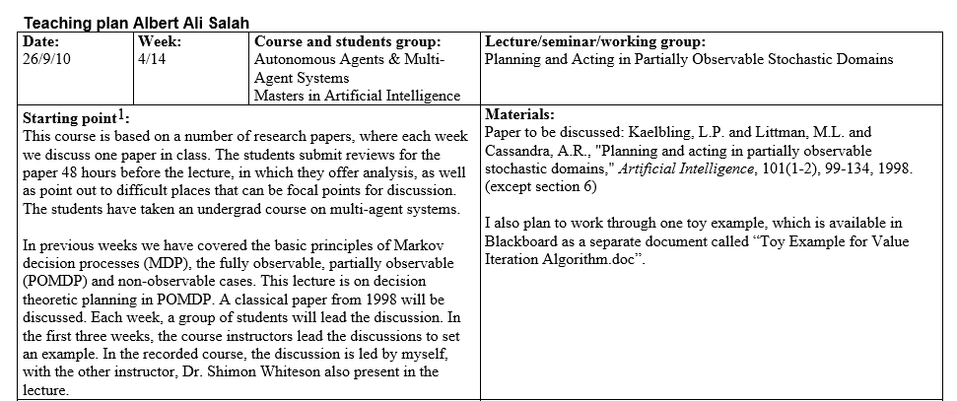
Sample teaching plan

Slide 34
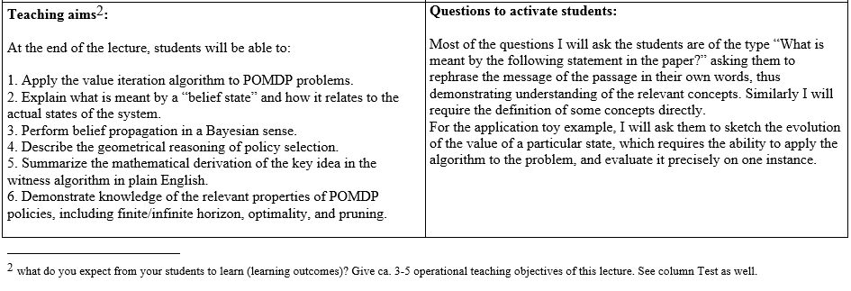
Sample teaching plan

Slide 35
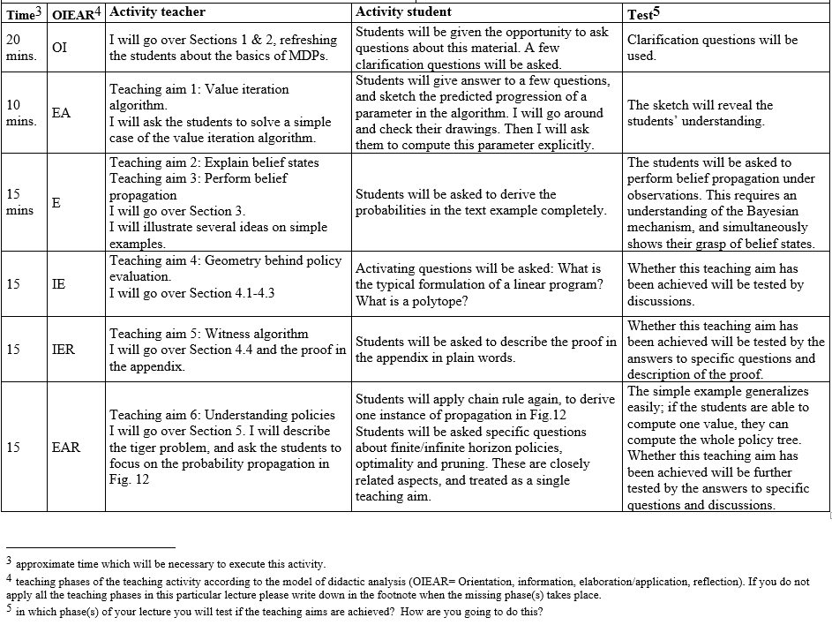
Sample teaching plan

Slide 36
Elements of style

Slide 37
Elements of style
Teaching in class is all about COMMUNICATION! All social signals are relevant, use them well.
Your aim is to give an AUDIENCE FOCUSED lecture.
Your stance is important. Always face the class, turn your back as little as possible. If you are using Powerpoint, never turn your face to your presented material. Always let them see your face clearly when you are speaking.
Speak in a clear and loud voice. Always think of the person in the far back, and speak to them (voice projection: you can train this).
Make sure you don’t appear shy or unsure of yourself.
Use the space in front of the board, fill the space with movement and gestures.

Slide 38
Elements of style
Keep eye-contact with students. All of them (not at the same time, obviously)
If you think the students are looking blank, you are probably correct:
  Ask a question to check whether they are still with you or not (don’t let the people in the front answer)
  Do an interactive activity to see it for yourself
  Tell a joke
If you know the names of students, use them. Learning the names is a big plus (but difficult)
There are ways of making students speak: Gaze scanning and waiting, open hand scanning, prolonged eye contact, direct addressing

Slide 39
Elements of style
Have a solid «opening» of the lecture. Always prepare the opening carefully!
Make sure you explain the purpose of activities, examples, etc. clearly before you introduce them. (Assume there is a student who just woke up)
  People learn by association. Tell them why they need a particular material before lecturing about it. This will make them associate it with existing knowledge, and then you will get more questions, more engagement, and more retention.
Do not be afraid to repeat material, remind the students of basic stuff, if this can be done quickly.

Slide 40
Elements of style
Be somewhat flexible about your teaching plan, especially if you feel that one phase did not succeed, and others depend on it.
  Keep in mind about depth being more important than breadth. If a topic is not understood, you may need to devote more time to it.
Get physically close to the students.
  The «socio-consultive zone» of interaction is 1.2 to 2.0 meters. Students in the back of the class are in the «public zone». Get them back into the socio-consultive zone. Give a small assignment, walk around and give individual feedback. Allow them to ask questions. If you realize that a question is relevant for all, go back to the board, and tell the class about that.

Slide 41
TA presentations and feedback

Slide 42
Assessment
While watching the presenter, pay attention to:
  What takes our attention most?
  How is the stance, eye-contact, sound and clarity, writing size (if applicable)
  Is the presenter activating the students?
  What are the strengths? Points of improvement?
Feedback is VERY important. Find yourself a feedback buddy, go to each others teaching sessions, and then provide (preferably written) feedback. Start with strengths, continue with points of improvements...

Slide 43
Q & A

