Slide 1
Fundamental Theorems in Mathematics
Dilara Gökay
8 November 2016

Slide 2
What does «theorem» mean?
a formula, proposition, or statement in mathematics or logic deduced or to be deduced from other formulas or propositions

Slide 3
There is a number of fundamental theorems in mathematics. The most commonly used and known ones are:
Fundamental Theorem of Arithmetic
Fundamental Theorem of Algebra
Fundamental Theorem of Calculus
Fundamental Theorem of Linear Algebra
A broader list can be found in here.

Slide 4
1) Fundamental Theorem of Arithmetic
The theorem says that every integer greater than 1 can be factored uniquely into a product of primes.
Proof: The proof derives from Euclid’s Lemma. It says that if a prime divides a product of two numbers, it must divide at least one of the numbers.

Slide 5
2) Fundamental Theorem of Algebra
The theorem states that every non-constant single-variable polynomial with complex coefficients has at least one complex root. This includes polynomials with real coefficients, since every real number is a complex number with an imaginary part equal to zero.
The theorem is also stated as follows: every non-zero, single-variable, degree n polynomial with complex coefficients has, counted with multiplicity, exactly n roots. The equivalence of the two statements can be proven through the use of successive polynomial division.

Slide 6
3) Fundamental Theorem of Calculus
The theorem connects integration and differentiation, enabling us to compute integrals using an antiderivative of the integrand function rather than by taking limits of Riemann sums.

Slide 7
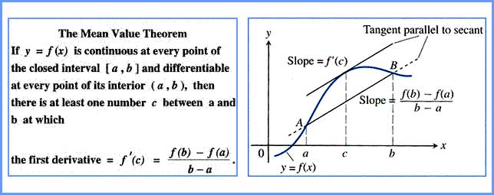
Mean Value Theorem
The theorem helps us to explain the fundamental theorem of calculus

Slide 8
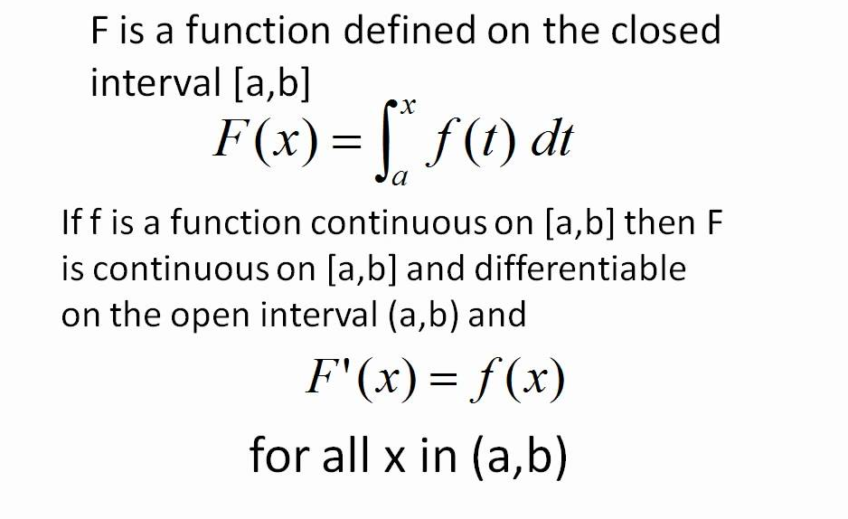
Fundamental Theorem of Calculus Part I

Slide 9
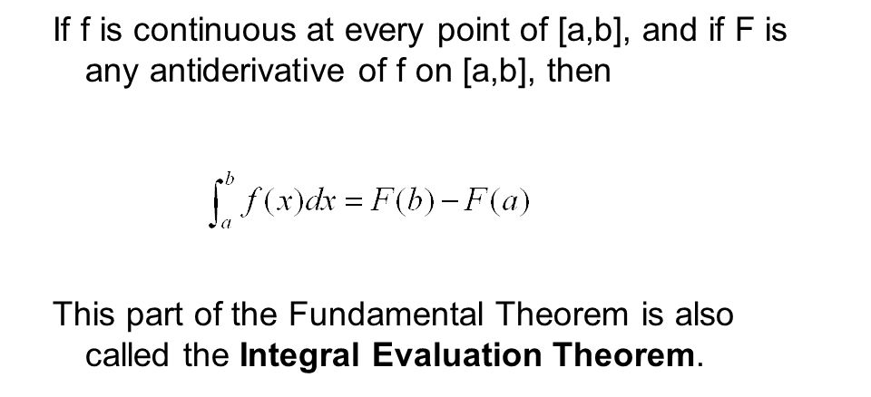
Fundamental Theorem of Calculus Part II

Slide 10
4) Fundamental Theorem of Linear Algebra
The theorem makes several statements regarding vector spaces:
column space
null space
row space
left null space

Slide 11
References
George B. Thomas Jr. «Thomas’ Calculus» Pearson Education. 2005. p. 356.
Gilbert Strang. «The Fundamental Theorem of Linear Algebra» The American Mathematical Monthly, Vol. 100, No. 9. (Nov., 1993), pp. 848-855.
Bruce Ikenaga. «The Fundamental Theorem of Arithmetic» 14 June 2008. p.1. Web. 7 Nov 2016. https://www.math.uh.edu/~minru/spring11/fundamental-theorem.pdf
Merriam Webster. Web. 7 Nov 2016. http://www.merriam-webster.com/dictionary/theorem
Web. 7 Nov 2016. https://en.wikipedia.org/wiki/Fundamental_theorem
Math Poster, Peter Jipsen. «Fundamental Theorems» 2007. Web. 7 Nov 2016. math.chapman.edu/~jipsen/mathposters/fundamentals.pdf
«Mean Value Theorem for Integrals» 2011. Web. 7 Nov 2016. https://apcalc-craigpeyton.wikispaces.com/Mean+Value+Theorem+for+Integrals
Web. 7 Nov 2016. http://curvebank.calstatela.edu/calculus/mvt1.jpg
math314. «Fundamental Theorem of Calculus Part 1» 4 Sep 2010. Web. 7 Nov 2016. https://www.youtube.com/watch?v=Ib568KmP5i0
Web. 7 Nov 2016. https://en.wikipedia.org/wiki/Fundamental_theorem_of_algebra
Delphia Haynes. «The Definite Integral» 2015. Web. 7 Nov 2016. http://slideplayer.com/slide/6418980/
Web. 7 Nov 2016. https://en.wikipedia.org/wiki/Fundamental_theorem_of_linear_algebra

